Slide 1
Opioid Addiction
David Kan, M.D.
University of California
San Francisco
VA Medical Center
San Francisco

Slide 2
History of Opioids

Slide 3
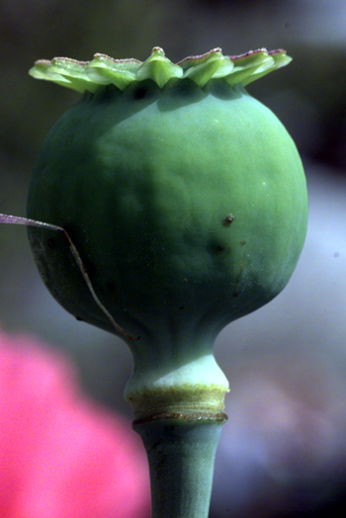
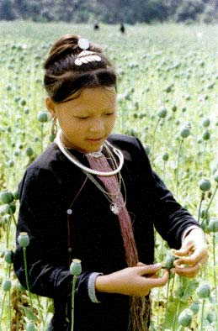
The “Pod of Pleasure”

Slide 4
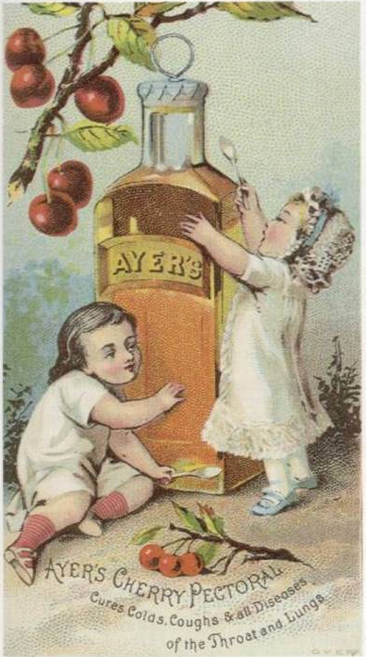
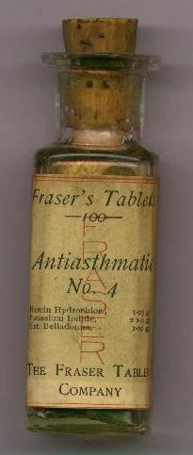
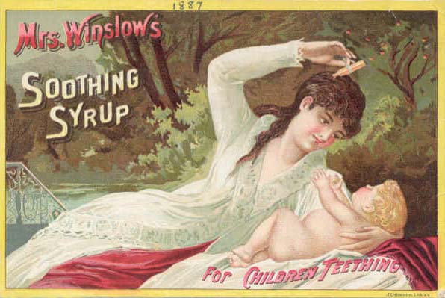
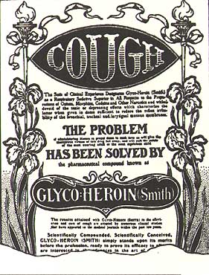
OTC Opiates

Slide 5
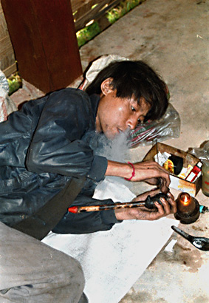
Opium
Smoker

Slide 6
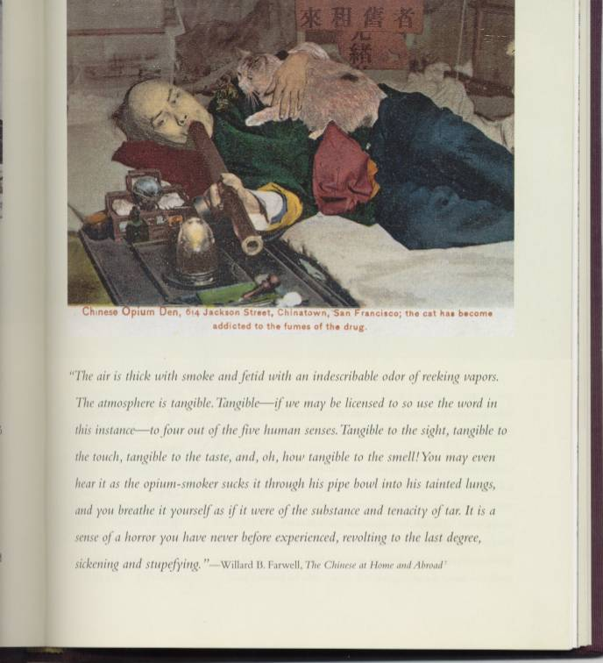
Opium in San Francisco

Slide 7
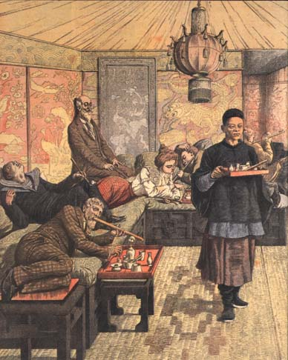
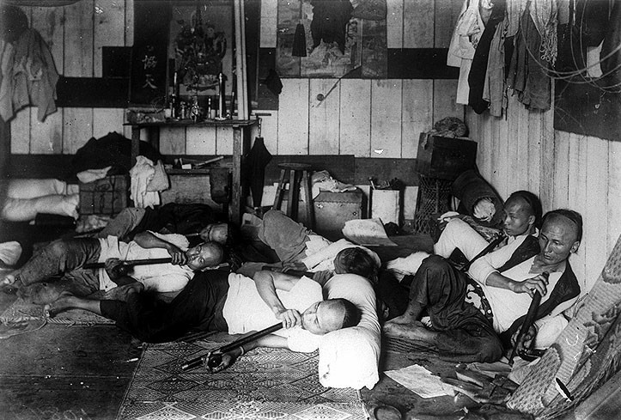
Gentlemen prefer…opium
Manila Opium Den
Gentleman’s Opium Den

Slide 8
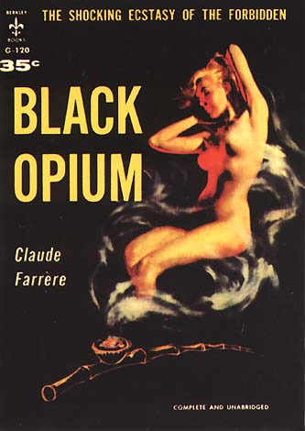
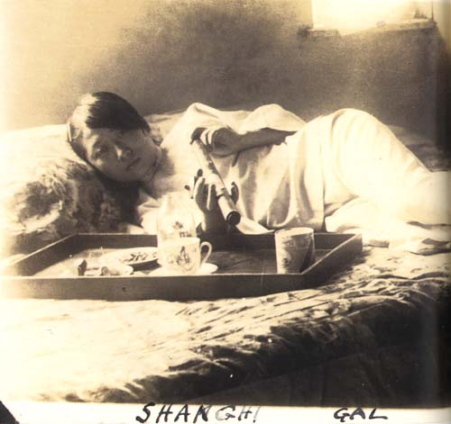
… & Shanghai Gal

Slide 9
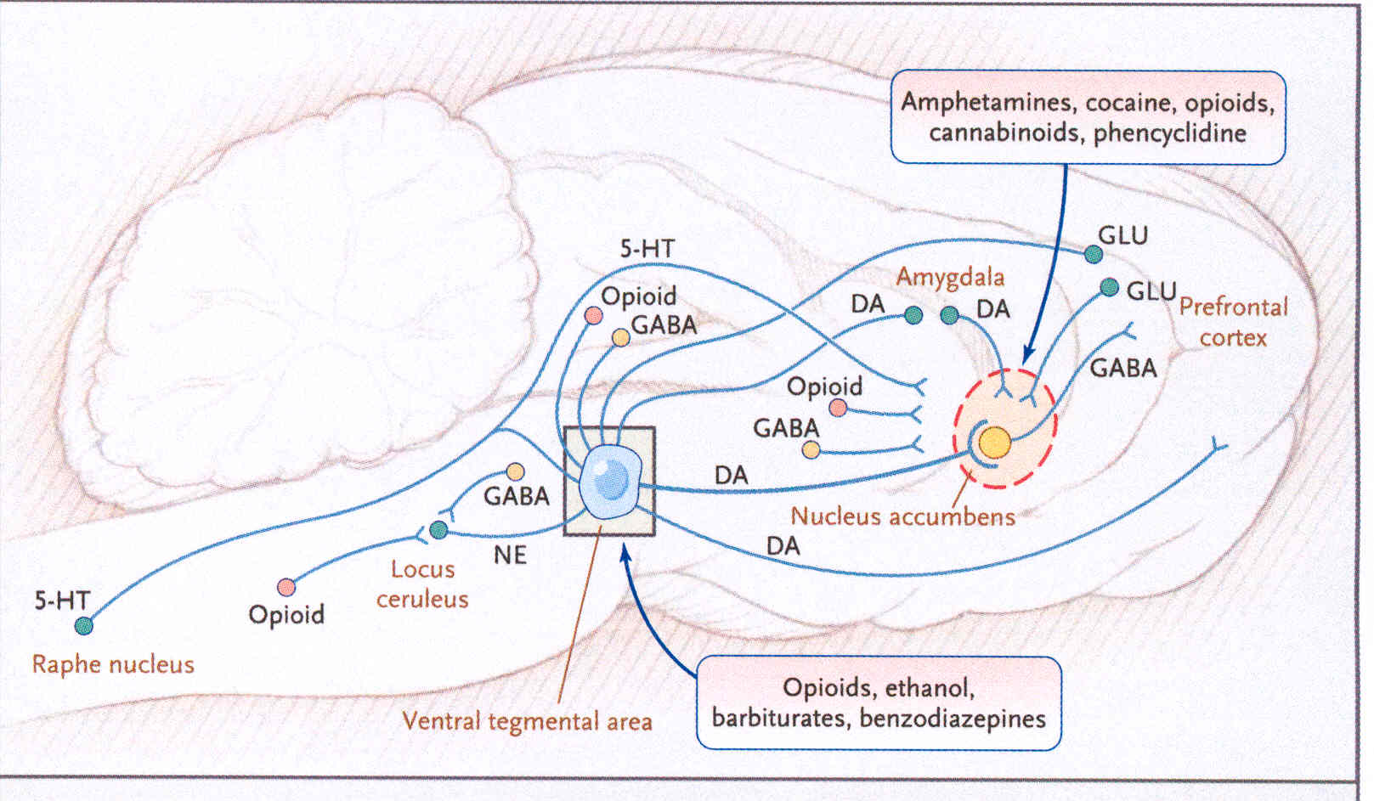
Multiple Neurotransmitters Contribute to Reward

Slide 10
Opioid Abuse (DSM-IV)
(1 or more within one year)
Failure to fulfill major role obligations at work, school, or home
Recurrent substance use in situations in which it is physically hazardous
Substance-related legal problems
Continued use despite social or interpersonal problems caused or exacerbated by the effects of the substance

Slide 11
Opioid Dependence (DSM-IV)
(3 or more within one year)
Tolerance
Withdrawal
Larger amounts/longer period than intended
Inability to/persistent desire to cut down or control
Increased amount of time spent in activities necessary to obtain opioids
Social, occupational and recreational activities given up or reduced
Opioid use is continued despite adverse consequences

Slide 12
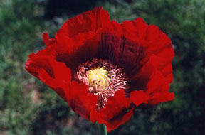
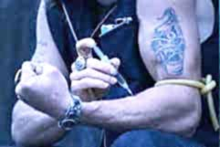
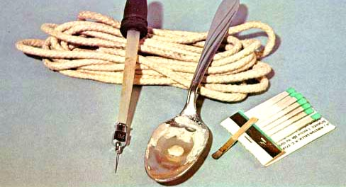
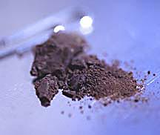
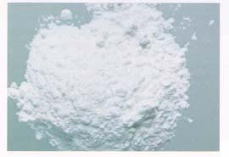
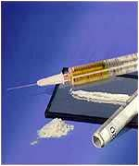
OPIATES

Slide 13
Epidemiology of Opioid Abuse
  1994-2001:
    Rates of addiction to prescription opioids increasing
    Emergency room visits related to opioid pain medications more than doubled
  SAMHSA Mortality Data From DAWN 2002

Slide 14
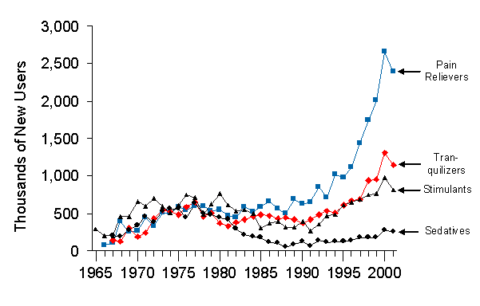
Number of new non-medical users of therapeutics

Slide 15
Annual Numbers of New Nonmedical Users of Pain Relievers: 1965-2002
Fig
5.3
Thousands of New Users
All Ages
Aged 18 or Older
Aged Under 18
1965
1970
1975
1980
1985
1990
1995
2000

Slide 16

Estimated Total Number of Heroin/Morphine-Related
Hospital Emergency Department Visits by Year (DAWN, 2002)
95,000
90,000
80,000
70,000
60,000
50,000
40,000
30,000
1988
1989
1990
1991
1992
1993
1994
1995
1996
1997
1998
1999
2000
2001

Slide 17
Non-Medical Use of Pain Relievers:
  Year: Lifetime Past Month
  1999: 19,888,000 2,621,000
  2000: 19,210,000 2,782,000
  2001: 22,133,000 3,497,000
  2002: 29,611,000 4,377,000
  2003: 31,207,000 4,693,000
  (NSDUH 2002, 2003)

Slide 18
Oxycodone

Slide 19
Oxycodone (OxyContin®)
Non Medical Users of Oxycodone
  Oxycodone 13.7 Million 5.8% 2003
  Oxycodone 11.8 Million 5.0% 2002
  7.2% of who use only Oxycodone meet criteria for opioid dependence/abuse in past year
Non-Medical Users of Heroin
  Heroin (all) 3.6 Million 1.6% 2002-03
  Heroin + Oxycodone 1.7 Million
  Heroin + Misc. 1.9 Million
NSDUH Report, Non-Medical Oxycodone Users:
A Comparison with Heroin Users, Jan 21, 2005

Slide 20
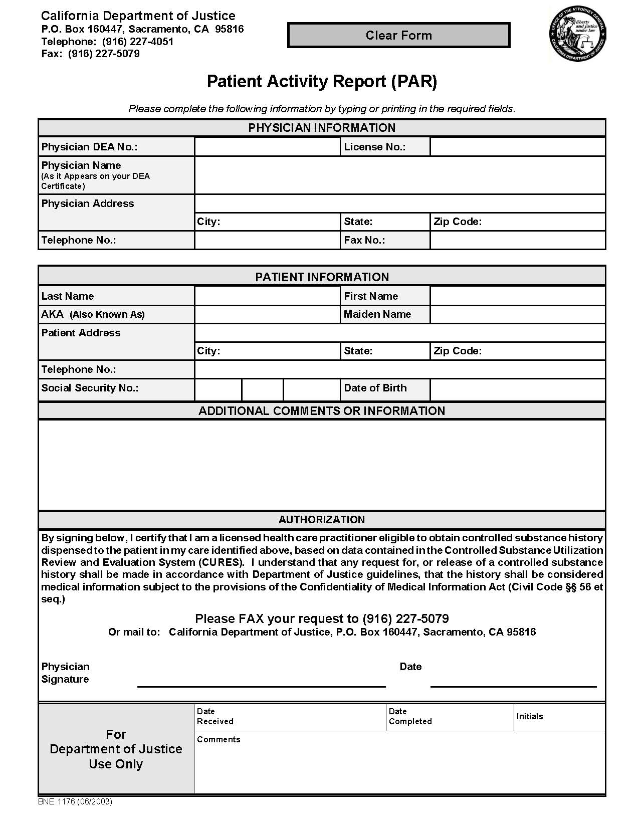
Triplicate
Review
http://www.ag.ca.gov/bne/pdfs/BNE1176.pdf
NOW AVAILABLE IN REAL TIME!

Slide 21
Black
Box

Slide 22
Why Crush OxyContin ?
Pharmaceutical opioids are usually taken orally but may also be injected. They may be crushed to circumvent the mechanisms which control (delay) the release of the active ingredients in long-acting formulations.
Notes:
1.

Slide 23
At Least One Non-Medical Use of Oxycontin During Lifetime
2002 National Survey on Drug Use and Health (NSDUH), SAMHSA, Sept 5, 2003

Slide 24
Commonly Abused Opioids
Diacetylmorphine Heroin
Hydromorphone Dilaudid
Meperidine Demerol
Hydrocodone Lortab, Vicodin
Oxycodone OxyContin,
Percodan,
Percocet, Tylox

Slide 25
Commonly Abused Opioids
Morphine MS Contin, Oramorph
Fentanyl Sublimaze
Propoxyphene Darvon
Methadone Dolophine
Codeine
Opium

Slide 26
Commonly Abused Opioids and Street Prices
Diacetylmorphine Heroin
$5/10/15 for 1/8 oz+adulterant
Hydromorphone Dilaudid
$5 to $100
Meperidine Demerol
$2.50 to $6 per pill
Hydrocodone Lortab, Vicodin
$2 to $10 per pill
Oxycodone OxyContin,
Percodan,
Percocet, Tylox
~$1 per milligram

Slide 27
Commonly Abused Opioids and Street Prices
Morphine MS Contin, Oramorph
Fentanyl Sublimaze
$20-25 per lollipop
$10-100 per patch
Propoxyphene Darvon
Methadone Dolophine
$0.50 per Milligram
Codeine
Opium

Slide 28
Street Names
  Morphine: M, Miss Emma
  Hydromorphone DLs (for Dilaudid)
  Oxycodone: Percs (for Percocet),
  Oxys (for OxyContin)
  Methadone: Meth,
  Done or Dolly’s
  (for Dolophine)

Slide 29
Lifetime Nonmedical Users of Selected Pain Relievers among Persons Aged 12 or Older: 2002 and 2003
Fig
2.4
↑
Numbers of Lifetime Users (in Millions)
↑
↑
↑
↑
↑
↑
Any Pain Reliever
Vicodin®,
Lortab®,
or Lorcet®
Percocet®,
Percodan®,
or Tylox®
Hydro-
codone
Oxy-
Contin®
Methadone
Tramadol
↑, ↓ = Significant change 2002 to 2003

Slide 30
Heroin 101
New production in South America
High purity/potency (smokeable)
Detoxification is of limited long-term efficacy
Most effective treatment for chronic users is Methadone Maintenance
Medications
  Methadone, LAAM Opioid Agonist Therapy
  Buprenorphine Partial Agonist Therapy
  Naltrexone Opioid Blockade

Slide 31
Heroin
Short acting opiate
Immediate effects:
  Heroin crosses the blood-brain barrier
  Heroin is converted to morphine and binds rapidly to opioid receptors
  Causes euphoria
  Pain relief
  Flushing of the skin
  Dry mouth
  Heavy feeling in the extremities

Slide 32
Heroin
After initial effects:
  Drowsy for several hours.
  Clouded mental function
  Slowed cardiac function
  Slowed breathing
    Death by respiratory failure (overdose)

Slide 33
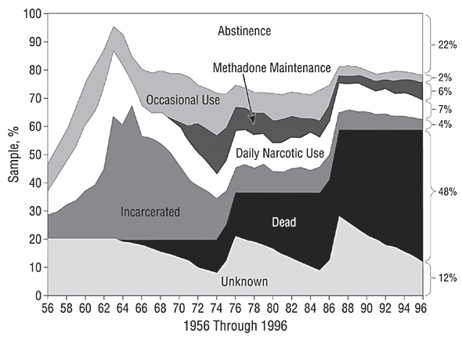
40 Year Natural History
of Heroin Addiction
48%
The natural history of narcotics addiction among a male sample (N = 581).
From: Yih-Ing, et. al., 2001. A 33-Year Follow-up of Narcotics Addicts. Archives of General Psychiatry, 58:503-508)
Notes:
Opiate addiction is a truly lethal disease.
This graph shows the 33 year history of California heroin addicts.
What you see in the black area, is the cumulative incidence of death in this sample.
By the end of 33 years nearly half – 48% – of heroin addicts are dead.
It is perhaps worth mentioning that the addicts were age 20 to 30 at the time they were initially identified in 1963.
This death rate is substantially higher, as high as about 10 times higher, than the rate for matched peers that are not heroin users.

Slide 34
Pharmacology

Slide 35
Endogenous Opioids and their Receptors
Opioid
Receptor
Types
Mu
Delta
Kappa
μ
κ
δ
H₂N
Opioid Classes
Endorphins
Enkephalins
Dynorphins
Endomorphins (?)
Extracellular
fluid
S
S
AA identical in 3 receptors
AA identical in
2 receptors
cell membrane
AA different in
3 receptors
cell interior
HOOC
LaForge, Yuferov and Kreek, 2000

Slide 36
Opioids
Naturally Occurring
  Opium, Tincture of Opium (Laudanum), Camphorated Tincture of Opium (Paregoric)
Semi-Synthetic
  Hydromophone (Dilaudid), Oxycodone (Percodan, Oxycontin), diacetylmorphine (heroin).
Synthetic
  Meperidine (Demerol), pentazocine (Talwin), methadone (Dolophine), propoxyphene (Darvon)

Slide 37
Opiates: Receptor Locations
Limbic System
Central Thalamus, substantia gelatinosa (spinal cord)
Solitary nuclei
Hypothalamus
Regulation of emotion, Euphoria.
Pain regulation, Analgesia
Decreased cough reflex
Decreased sexual drive

Slide 38
Opioid Receptors
Receptor | Subtypes | Location | Function
delta (δ) OP₁ ^{(I)} | δ₁, δ₂ | Brain pontine nuclei amygdala olfactory bulbs deep cortex | analgesia antidepressant effects physical dependence
kappa (κ) OP₂ ^{(I)} | κ₁, κ₂, κ₃ | Brain hypothalamus periaqueductal gray Claustrum Spinal cord substantia gelatinosa | Spinal analgesia sedation miosis inhibition of ADH release
mu (μ) OP₃ ^{(I)} | μ₁, μ₂, μ₃ | Brain cortex (laminae III and IV) thalamus striosomes periaqueductal gray Spinal Cord substantia gelatinosa | μ₁: Supraspinal analgesia physical dependence μ₂: respiratory depression miosis euphoria reduced GI motility physical dependence

Slide 39
Opiates: Withdrawal
Grade O
  Drug Craving, anxiety
  Drug-seeking behavior
Grade 1 (Early 12-36 hours)
  Yawning, Perspiration, lacrimation, rhinorrhea
  Poor sleep
Grade 2 (Early 12-36 hours)
  Mydriasis (with decreased light reaction)
  Goose flesh (“cold turkey”)
  Muscle twitches (“kicking”)
  Hot and cold flashes, chills, aching bones and muscles
  Anorexia, irritability, resting tremor
Late (48-72 hours)
  Diarrhea, vomiting, nausea, weakness
  Increased BP
  Insomnia
  Fever (<100 degrees)

Slide 40
COWS Clinical Opiate Withdrawal Scale
Wesson & Ling, J Psychoactive Drugs. 2003 Apr-Jun;35(2):253-9.
Resting Pulse Rate: _________beats/minute Measured after patient is sitting or lying for one minute 0 Pulse rate 80 or below 1 Pulse rate 81-100 2 Pulse rate 101-120 4 Pulse rate greater than 120 | GI Upset: over last 1/2 hour 0 No GI symptoms 1 Stomach cramps 2 Nausea or loose stool 3 Vomiting or diarrhea 5 Multiple episodes of diarrhea or vomiting
Sweating: over past 1/2 hour not accounted for by room temperature or patient activity. 0 No report of chills or flushing 1 Subjective report of chills or flushing 2 Flushed or observable moistness on face 3 Beads of sweat on brow or face 4 Sweat streaming off face | Tremor observation of outstretched hands 0 No tremor 1 Tremor can be felt, but not observed 2 Slight tremor observable 4 Gross tremor or muscle twitching
Restlessness Observation during assessment 0 Able to sit still 1 Reports difficulty sifting still, but is able to do so 3 Frequent shifting or extraneous movements of legs/arms 5 Unable to sit still for more than a few seconds | Yawning Observation during assessment 0 No yawning 1 Yawning once or twice during assessment 2 Yawning three or more times during assessment 4 Yawning several times/minute
Pupil size 0 Pupils pinned or normal size for room light 1 Pupils possibly larger than normal for room light 2 Pupils moderately dilated 5 Pupils so dilated that only the rim of the iris is visible | Anxiety or irritability 0 None 1 Patient reports increasing irritability or anxiousness 2 Patient obviously irritable anxious 4 Patient so irritable or anxious that participation in the assessment is difficult
Bone or Joint aches If patient was having pain previously, only the additional component attributed to opiates withdrawal is scored 0 Not present 1 Mild diffuse discomfort 2 Patient reports severe diffuse aching of joints/ muscles 4 Patient is rubbing joints or muscles and is unable to sit still because of discomfort | Gooseflesh skin 0 Skin is smooth 3 Piloerrection of skin can be felt or hairs standing up on arms 5 Prominent piloerrection
Runny nose or tearing Not accounted for by cold symptoms or allergies 0 Not present 1 Nasal stuffiness or unusually moist eyes 2 Nose running or tearing 4 Nose constantly running or tears streaming down cheeks | Total Score _________ The total score is the sum of all 11 items Initials of person completing Assessment:________________
Score: 5-12 mild; 13-24 moderate; 25-36 moderately severe; more than 36 = severe withdrawal

Slide 41
Opioid Withdrawal Severity
Heroin
Buprenorphine
Severity of Withdrawal
Methadone
0
5
10
15
Days Since Last Opiate Dose
Kosten & O’Connor, NEJM 348;18, May 1, 2003

Slide 42
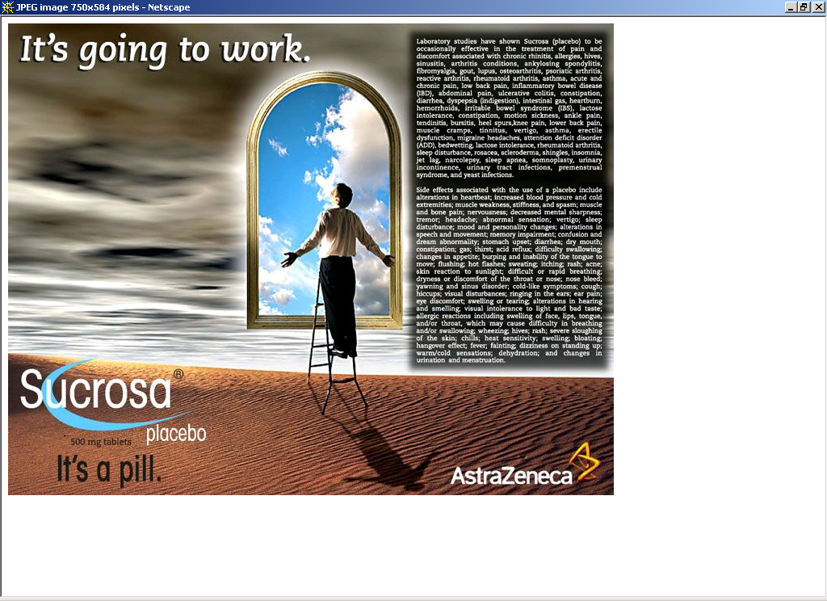
Set & Setting

Slide 43
Opiate Addiction: Medications
Detoxification
  Opioid Replacement
    Methadone (Agonist)
    [Illegal on outpatient basis]
    Buprenorphine (Partial Agonist)
    [Requires special DEA license]
  Non-Opioid Symptom Relief
    Clonidine (Catapres), alpha-2 adrenergic agonist
    Lofexadine
    Anti-spasmodic, anti-diarrheals
    NSAIDS for bone pain and myalgia
    Sleep meds

Slide 44
Opiate Addiction: Medications
Maintenance
  Opioid-Free
    Naltrexone
  Opioid-Agonist
    Methadone
    Buprenorphine

Slide 45
Naltrexone & Opioid Blockade
Extinction Paradigm
  Attempts at opiate use produce no “high”
Craving Reduction
  Craving is highly situational. It is reduced when heroin cannot work.
Naltrexone Dysphoria??
  Unclear whether the blockade of endogenous opioids produces dysphoria or a loss of a sense of wellbeing

Slide 46
Naltrexone:
Efficacy vs. Effectiveness
High Efficacy:
  An almost perfect, long-acting blocker of opiates
Limited Effectiveness:
  Most effective in monitored treatment of medical or other professionals, executives, and individuals on probation
  Poor compliance in heroin-using population
  Poor treatment retention
Combined Strategies:
  Continengy management and family therapy
  Criminal Justice leverage

Slide 47
UROD: UltraRapid Opioid Detoxification
Under general anesthesia administered opioid antagonist
Continue opioid antagonist for several months
Cost $5,000 – $20,000
Few long-term clinical trials, none demonstrate improved results
Potential risks high

Slide 48
Clonidine For Opioid Withdrawal
Principle:
Alpha-2 adrenergic agonist,
suppresses activity in locus ceruleus,
Decreases most withdrawal symptoms
Advantages: partial relief of symptoms
Disadvantages:
Requires dose titration, orthostatic hypotension,
Does not treat insomnia, myalgias or craving
Protocol:
0.1-0.2 mg. q 4 hours,
up to 1.2 mg/24 hours for 10 to 14 days
David Fiellin, M.D.

Slide 49
Opiate Addiction: Maintenance
Methadone
  Dole & Nyswander’s opioid deficiency theory (1964).
  Daily Dosing, Blocking dose usually > 60 mg qd
LAAM
  Every other day dosing or 2-days a week
  Rare prolongation of QTc interval on EKG
Buprenorphine
(formulated with or without naloxone)
  Partial Agonist (high opiate receptor avidity but low innate activity)
  Daily dosing, 2-32 mg qd

Slide 50
Methadone for Withdrawal
Substitution:
  Long-acting opioid for short-acting
Taper:
  20-30 mg qd for 2-3 days
  Taper by 10-15% per day
High Efficacy & Low Effectiveness
  Very poor longer term outcome results from either 21-day or 180-day detoxification protocols

Slide 51
Methadone Maintenance
The Gold Standard

Slide 52
Impact of MMT on IV Drug Use for
388 Male MMT Patients in 6 Programs
100%
100
81.4%
63.3%
LAST ADDICTION PERIOD
41.7%
PERCENT IV USERS
ADMISSION
*
28.9%
*
0
Pre- | 1st Year | 2nd Year | 3rd Year | 4th
Adapted from Ball & Ross - The Effectiveness of Methadone Maintenance Treatment, 1991

Slide 53
Recent Heroin Use by Current Methadone Dose
% Heroin Use
Current Methadone Dose mg/day
Opioid Agonist Treatment of Addiction - Payte - 1998
J. C. Ball, November 18, 1988

Slide 54
Crime among 491 patients before and during MMT at 6 programs
Crime Days Per Year
Adapted from Ball & Ross - The Effectiveness of Methadone Maintenance Treatment, 1991

Slide 55
Relapse to IV drug use after MMT
105 male patients who left treatment
Percent IV Users
Months Since Stopping Treatment
Adapted from Ball & Ross - The Effectiveness of Methadone Maintenance Treatment, 1991
Opioid Agonist Treatment of Addiction - Payte - 1998

Slide 56
Death Rates in
Treated and Untreated Addicts
% Annual Death Rates
Slide data courtesy of Frank Vocci, MD, NIDA –
Reference: Grondblah, L. et al. Acta Pschiatr Scand, P. 223-227, 1990

Slide 57
40 Year Natural History
of Heroin Addiction
48%
The natural history of narcotics addiction among a male sample (N = 581).
From: Yih-Ing, et. al., 2001. A 33-Year Follow-up of Narcotics Addicts. Archives of General Psychiatry, 58:503-508)
Notes:
Opiate addiction is a truly lethal disease.
This graph shows the 33 year history of California heroin addicts.
What you see in the black area, is the cumulative incidence of death in this sample.
By the end of 33 years nearly half – 48% – of heroin addicts are dead.
It is perhaps worth mentioning that the addicts were age 20 to 30 at the time they were initially identified in 1963.
This death rate is substantially higher, as high as about 10 times higher, than the rate for matched peers that are not heroin users.

Slide 58
Methadone Maintenance Outcomes
Gold-Standard for Opioid Treatment
  One of the most over-proven treatments in entire psychiatry and drug abuse literature
  Detoxification methods succeed only < 3% of the time.
Outcomes Measures
  Reduction of …
    Death rates (8-10X reduction)
    Drug use
    Criminal activity
    HIV spread
  Increase in …
    Employment
    Social stability
    Retention, medication compliance, and monitoring

Slide 59
Methadone as Medication
Long acting
  Prevents withdrawal for 24-36 hours
Competitive Opioid Blockade
  Blocks heroin euphoria
Medically safe
  10-18 year studies support medical safety
  Use in pregnant opioid addicts
(Physician’s Guide: Opioid Agonist Medical Maintenance Treatment; CSAT, 2000)

Slide 60
Methadone Pharmacology
Mu agonist
Oral
  80-90% oral bioavailability
  Half life 24-36 hours
Analgesia:
  Single dose analgesic properties similar to morphine in potency and duration
Accumulation
  In non-tolerant patients, with repeated use for pain, can result in sedation and respiratory depression

Slide 61
Methadone Absorption
Pharmacokinetics
  Initial effects 30 minutes after oral dose
  Peak plasma levels in 2-4 hours
Reservoir Effect
  Stored in liver and other tissues for later release into circulation
Protein binding
  Extensive, up to 90% of therapeutic dose
Lipophilic
  Parenteral doses readily cross blood-brain barrier

Slide 62
Methadone Metabolism & Excretion
Liver Metabolism
  N-demethylation and cyclization
    pyrrolodines (EDDP)
    pyrroline (EMDP)
  Metabolites are essentially inactive
Excretion
  Metabolites and unchanged methadone are excreted in bile and urine

Slide 63
Methadone Medication Interactions
Cytochrome P-450 Enzyme Activity
Induction by
  Rifampin
  Phenytoin
  Ethyl Alcohol
  Barbiturates
  Carbemazepine
Inhibition by
  Cimetidine
  Ketoconazole
  Erythromycin
Tacrolimus and cyclosporine, immunosuppresants commonly used in liver transplantation, and methadone use the cytochrome P-450 system (CYP3A4).

Slide 64
Opiate Addiction:
Relapse Prevention
Narcotics Anonymous
Therapeutic Community
Naltrexone (Opioid Blockade)
  Naltrexone 50 mg qd
  Need to monitor LFT’s periodically

Slide 65
Buprenorphine
The New Kid on the Block
(but not everybody likes him)

Slide 66
Buprenorphine Pharmacology
A Partial (Mu) Opioid Agonist
Profile of effects is similar to other Mu opioids, but with less risk of…
  Respiratory depression
  Physical dependence
  Problematic withdrawal
It can be abused, usually as a secondary drug of availability

Slide 67
Buprenorphine Clinical Trial
1996-1999 a large, randomized, double blind, multisite study
Using buprnorphine mono and combined therapy vs placebo
Terminated early by FDA because of substantial efficacy and continued as a safety study
SF VAMC was one of the sites
  Patients received regular counseling with medication- Important aspect of treatment

Slide 68
How Long Has Suboxone been Used for Opiate Addiction?
Available in US since 2003
In Europe since mid-90’
More than 400,000 opiod dependent patient treated worldwide

Slide 69
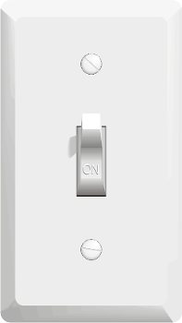
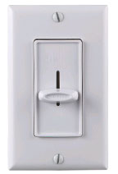
Partial vs. Full agonist
Methadone
  On vs. Off
  Full agonist
Buprenorphine
  Dimmer Switch
  Partial agonist

Slide 70
Buprenorphine:
Affinity & Dissociation
High Affinity for Mu Opioid Receptor.
  Competes with other opioids and blocks their effects
Slow Dissociation from Mu Opioid Receptor
  Prolonged therapeutic effect

Slide 71
EFFICACY: Full Agonist Methadone
Partial Agonist Buprenorphine
Antagonist Naloxone
100
90
80
70
60
50
40
30
20
10
0
Full Agonist
(Methadone)
%
Efficacy
Partial Agonist
(Buprenorphine
Antagonist
(Naloxone)
-10 -9 -8 -7 -6 -5 -4
Log Dose of Opioid

Slide 72
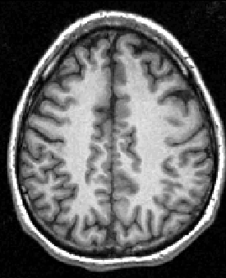
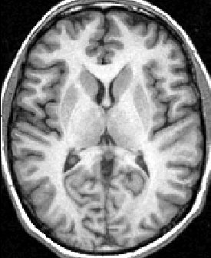
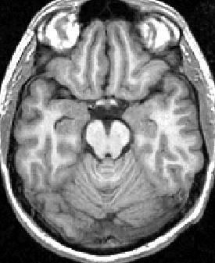
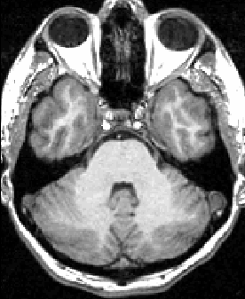
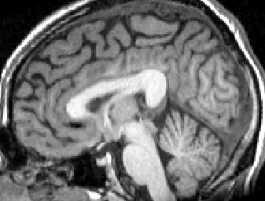
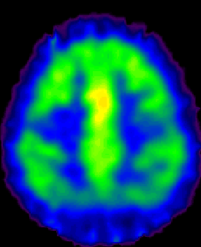
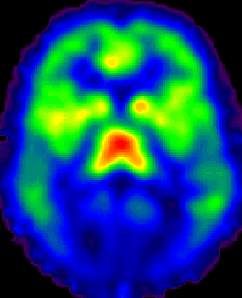
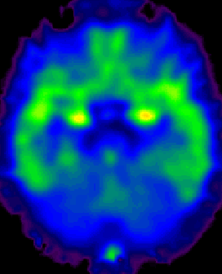
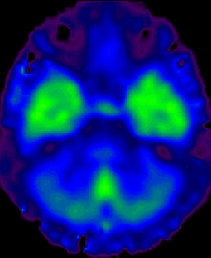
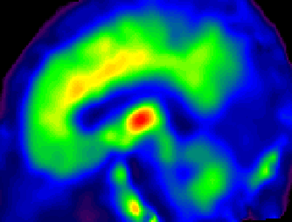
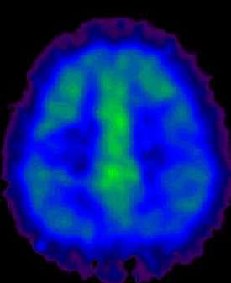
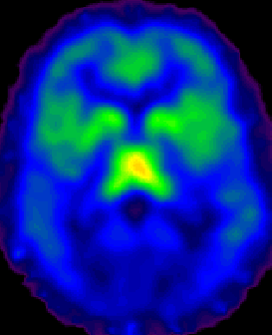
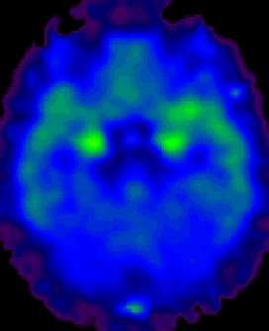
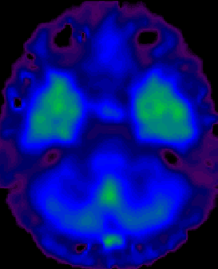
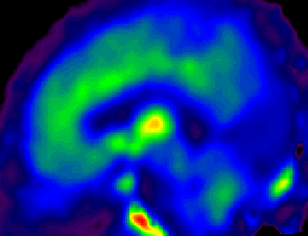
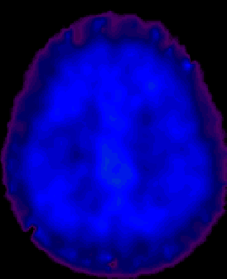
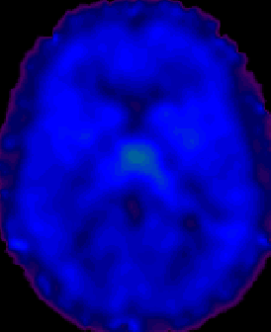
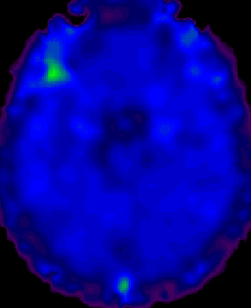
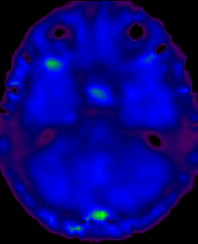
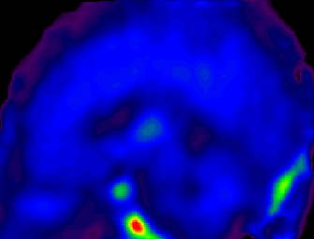
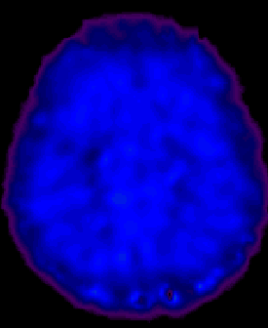
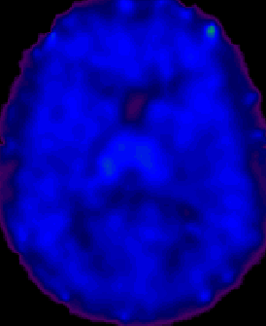
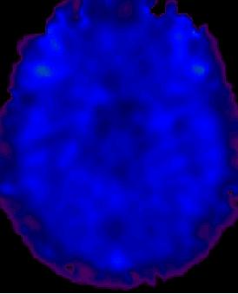
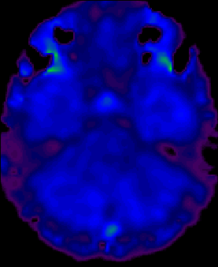
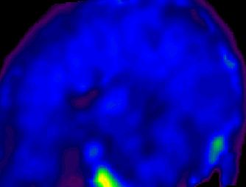
Effects of Buprenorphine Dose on µ-Opioid Receptor Availability in a Representative Subject
MRI
Bup 0 mg
Binding
Potential
(Bmax/Kd)
Bup 2 mg
4 -
Bup 16 mg
0 -
Bup 32 mg

Slide 73
Buprenorphine, Methadone, LAAM:Opioid Urine Results
All Subjects
100
80
LAAM
49%
60
Buprenorphine
40%
Hi Meth
Mean % Negative
40
39%
Lo Meth
20
19%
0
1
3
5
7
9
11
13
15
17
Study Week
Adapted from Johnson, et al., 2000

Slide 74
1-year Placebo-Controlled RCT CONSORT Graph
No. Assessed for Eligibility: 84
All Patients:
Group CBT Relapse Prevention
Weekly Individual Counseling
Three times Weekly Urine Screens
No. Excluded: 44
Not Meeting Inclusion Criteria: 41
Refused to Participate: 2
Other Reasons: 1
No. Randomized:
40
Allocated to Buprenorphine: 20
Received Buprenorphine: 20
Allocated to Detox: 20
Received Detox: 20
Included in analysis: 20
Excluded from analysis: 0
Included in Analysis*: 20
Excluded from Analysis: 0
David Fiellin, M.D., Yale Univ.

Slide 75
Retention in treatment
20
15
Remaining in treatment (nr)
10
5
Detox
Buprenorphine
Maintenance
0
0
50
100
150
200
250
300
350
100
150
Treatment duration (days)

Slide 76
Buprenorphine RCT
A tragic appendix:
 | Detox | Buprenorphine | Cox regression
Dead | 4/20 (20%) | 0/20 (0%) | χ²=5.9 p=0.015

Slide 77
Buprenorphine Summary
Well accepted maintenance therapy
Mild withdrawal
Decreases opioid use
Greater safety
Lower diversion potential

Slide 78
Suboxone Tablets
Contain Buprenorphine to relieve withdrawal symptoms from opiates
Also contains Naloxone to stop people from diverting and injecting the medication
Naloxone injected= severe withdrawal
Naloxone sublingal= no effect

Slide 79

HOW TO TAKE SUBOXONE
VEINS UNDER TONGUE
Suboxone is absorbed through the two large veins under the tongue.
Suboxone.comk

Slide 80
Taking Suboxone
Moisten mouth with a drink of water
Place tablets under tongue
Lean head slightly forward
Let the tablets dissolve completely
Usually takes 5-10 minutes to dissolve
DO NOT talk, it may “leak out”
DO NOT chew or swallow tablets

Slide 81
A Differentiated Strategy For Treatment Of Opioid Dependence (David Fiellin, MD)
Buprenorphine-
assisted
treatment.
Effective?
Methadone-
assisted
treatment.
Effective?
yes
no
Dependence?
(>1 year; age >20)
no
yes
yes
Psychosocial treatment
+Naltrexone?
Effective?
no
OK. Stabilization. Rehabilitation.
Discontinuation?
yes

Slide 82
Opiates In Primary Care
Opioid Analgesic Drug-Seeking
  Multiple Prescribers
  Lost, stolen, waterlogged prescriptions
  Calif. Dept. of Justice Controlled Substances Profile
Smoked heroin is addicting.
Increasingly seen in colleges
Dispensing Contracts
Consultation, Teamwork, System of Care

Slide 83
Summary:
Heroin remains a lethal drug
48%+ Death Rate / 33 years
Prescription opiate addiction, especially Oxycodone, has been accelerating since 1995
Opiate withdrawal is uncomfortable (flu-like syndrome) but not dangerous

Slide 84
Summary
Aggressive medical treatments for withdrawal can have serious, even lethal, consequences.
Efficacy and Effectiveness often diverge in treatment of opiate addiction
Methadone Maintenance is the Gold Standard for good outcomes
Buprenorphine has a better safety profile, and it may be prescribed from MD offices.

Slide 85
Summary
Detox is not treatment, it is a preparatory step in early treatment
Ultra-Rapid Detox methods have substantial morbidity risks and high cost.
Retention >90 days is a valuable treatment goal

Slide 86
One Idea Synopsis…
Detox is easy,
Recovery is hard.

