Slide 1
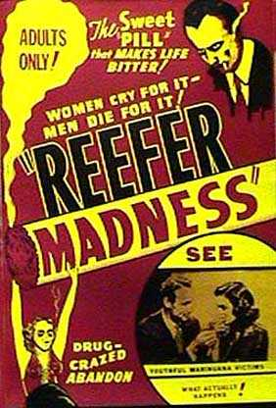
Medical Marijuana: What the California Physician Needs to Know
Presented By: David Kan, MD

Slide 2
Cannabis
Epidemiology
Cannabis Basics
Physical and Psychological Effects
Legal Issues
Evidence Base for Medicinal Marijuana

Slide 3
Cannabis Usage
In 2008 – regular users (Past-Month)
8th Grade – 1.4%
10th Grade – 7.7%
12th Grade – 17.8%
In 2008
15,203,000 regular users of Marijuana
20,077,000 regular users of any illicit drug

Slide 4
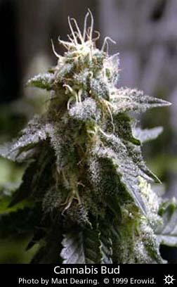
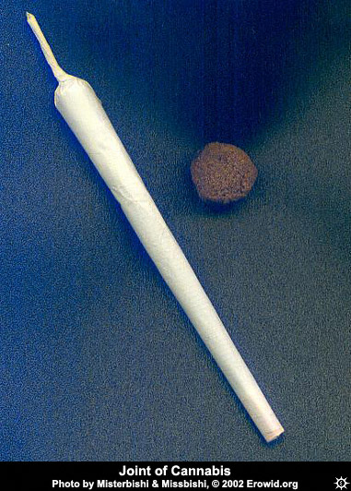
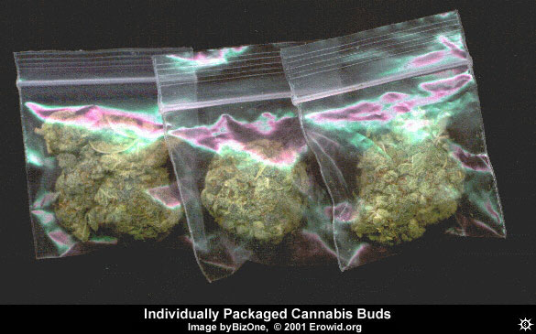
What is it?

Slide 5
Cannabis Basics
Leafy Plant
Cultivated indoors and outdoors
Flowering tops – “The Bud”
Cannabis v. Hemp
Species
Sativa, Indica, Ruderalis

Slide 6
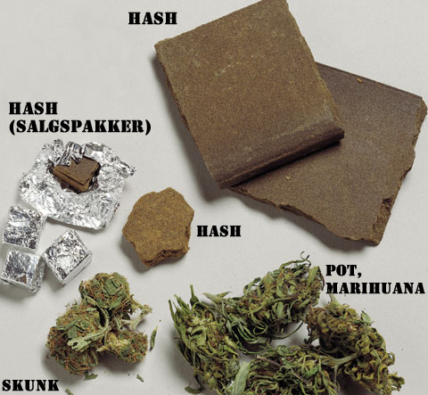
Cannabis Basics
Preparations
Dried Bud
Hashish
Hash Oil
Use
Smoked, Eaten

Slide 7
Cannabis Basics
Dosage
In 1960’s – 0.2 to 1% THC per weight
In 2003 – 3% to 25% THC
1/8 Oz is enough for 20-30 people
Price
$25-140 per ¼ oz.

Slide 8
Cannabis Basics
Chemistry
Cannabinoids / Receptors
Smoked
Quick effect
Peaks at 20 min. Lasts 1-2 hours
Eaten
Onset 1-2 hours
Effects last for 3-4 hours

Slide 9
Cannabis Basics
>400 compounds and 60 cannabinoids
Main psychoactive compound is THC (Tetrahydrocannabinol)
Cannabinoids found in Cannabis Sativa
Delta-9-THC is principal psychoactive component
Brain binding sites discovered in late 1980’s
1990 – Receptor CB1 first cloned and sequenced
Anandamide – Natural analogue

Slide 10
Cannabinoid Receptors
Widely distributed in brain
Reside within neural lipid membranes
Neuromodulators
Though intracellular G-proteins controlling cAMP formation and Ca++ and K+ ion transport
Post-synaptic reverse signaling contingent on firing rates

Slide 11
Endocannabinoid System and Addiction
CB1 receptor agonists are rewarding
Activate endogenous DA system
Cannabinoids have strong interactions with the opioid system: THC → increase B-endorphin in NAcc & VTA
Involved in rewarding effects of Alcohol
Synergistic with Nicotine rewarding effects
Inconsistent research regarding cocaine/ammphetamine
Solinas, et al: The endocannabinoid system in brain reward processes, Br J Pharmacol v.154(2); May 2008

Slide 12
Psychological Effects

Slide 13
Psychological Effects
Euphoria, relaxation, changes in perception
Effect Dosage dependent
Low
Sense of well-being
Enhancement of senses
Subtle changes in thought and expression
Talkativeness, giggling
Increased appetite

Slide 14
Psychological Effects
Higher Doses
Visual distortion
Sense of time altered
Attention span and memory affected
Thought processing
Mental Perception

Slide 15
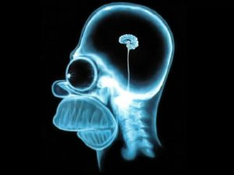
Psychological Effects
At Any Dose
Reduced ability to concentrate
Impaired Memory
Tiredness
Confusion

Slide 16
Psychological Effects
Different effects in older
– More unpleasant with oral>smoked
Multifaceted Symptoms
Potential use as adjunctive medication
Movement d/o and nausea
Anxiety has influence – may be indirect effect, false drug effect

Slide 17
Physical Risks
Lung and throat problems
Carcinogenic effects (controversial)
Decreased eye pressure
Allergies
Heart Issues
MI + Stroke Risk >5 times in acute intoxication
Mittleman, et al, Triggering Myocardial Infarction by Marijuana, Circulation. 2001;103:2805.

Slide 18
Physical Risks
Harms within range of effects tolerated for other substances
Medicinal SE not necessarily comparable to SE of drug abuse
Harmful effect studies based on smoked MJ and not on cannabinoid

Slide 19
Acute Risks
Diminished psychomotor performance
Do not operate heavy machinery or vehicle
Dysphoria or unpleasant feelings
Short-term immunosuppressive effects do not necessarily preclude use

Slide 20
Chronic Effects
Chronic Smoking vs. Effects of THC
Smoke associated with:
Cancer – when combined with tobacco
Lung damage
Poor pregnancy
Habitual Marijuana smoking per se lacks good studies

Slide 21
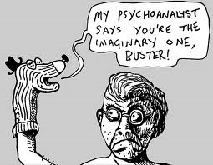
Cannabis and Psychosis
On an individual level, cannabis use confers an overall twofold increase in the relative risk for later schizophrenia.
At the population level, elimination of cannabis use would reduce the incidence of schizophrenia by approximately 8%, assuming a causal relationship.
Causal association between cannabis and psychosis: examination of the evidence, Louise Arseneault, PhD et al, BJP 2004 184: 101

Slide 22
Patterns of Abuse
Continuum of use/abuse
Occasional users – in groups, ritualized
More frequent users
Weekly or daily
Compulsive users
How much time is spent using or acquiring the drug
What happens in rest of life?
Is it used in combination with other drugs
REMEMBER – Abuse diagnosis takes into account consequences

Slide 23
Legal Issues
Prop 215 (Compassionate Use Act of 1996)
Exempts patients and defined caregivers who possess or cultivate marijuana recommended by a physician from criminal laws which otherwise prohibit possession or cultivation of marijuana.
Provides physicians who recommend use of marijuana for medical treatment shall not be punished or denied any right or privilege.
Declares that the measure is not to be construed to supersede prohibitions of conduct endangering others or to condone diversion of marijuana.

Slide 24
Legal Issues
Prop 215
Does not legalize cannabis
Changes treatment of patients and caregivers treatment in court system
Is NOT a prescription
Local Legislation
Frequency of examination
Cannabis distribution

Slide 25
Legal Issues
Doctor’s Recommendation allows Prop 215 protection
MD may be required to testify if patient arrested
Recommendation good for duration of treatment plan
Can change
http://www.drugpolicy.org/library/cmrguide.cfm

Slide 26
Legal Issues
Cultivation
Legal to grow for medical use
But feds may still prosecute
Only allowed enough for personal use
No strict guidelines
Distribution liable to federal prosecution
Monterey Co. Limits:
6 Mature Plants or 12 immature plants AND 8 ounces of bud

Slide 27
Legal Issues
No insurance mandate to pay for services
Drug Free Workplace Act
DUI laws still apply
Can’t tell patient how to obtain cannabis

Slide 28
Federal Review
Conant v. Walters (9th Cir. 2002) 209 F.3d 629
Severe Nausea
Wasting Syndrome
Increase intraocular pressure
Seizures
Muscle Spasms associated with chronic, debilitating condition (MS/Paralysis)
Severe, Chronic pain
Does not explicitly extend to other diseases or conditions

Slide 29
Recommendations
Smoked Marijuana
Short-term
Terminally ill or those with debilitating symptoms
Future Developments
Non-smoked
Rapid-delivery, rapid-onset
Years before perfect drug
Weigh risks and benefits

Slide 30
Good Doctoring
History and good faith examination of the patient.
Development of a treatment plan with objectives.
Provision of informed consent including discussion of side effects.
Periodic review of the treatment's efficacy.
Consultation, as necessary.
Proper record keeping that supports the decision to recommend the use of medical marijuana.
http://www.medbd.ca.gov/medical_marijuana.htm

Slide 31
Warnings
Federal Liability still present
A patient need not have failed on all standard medications
Determine that medical marijuana use is not masking an acute or treatable progressive condition, or use will worsen condition
Evidence Based practice
Risk/Benefit ratio
A consultant can recommend MM, but should consult with PCP and obtain records to confirm diagnosis.

Slide 32
Warning Continued
The initial examination must be in-person.
Recommendations should be limited to the time necessary to appropriately monitor the patient.
Periodic reviews should occur and be documented at least annually or more frequently as warranted.
If a physician recommends or approves the use of medical marijuana for a minor, the parents or legal guardians must be fully informed of the risks and benefits of such use and must consent to that use.

Slide 33
Medicinal Marijuana
Effects of isolated cannabinoids
Health risks associated with the medical use of marijuana
Efficacy of marijuana

Slide 34
Cannabinoid Biology
Cannabinoids have natural role in pain modulation, control of movement and memory
Immune system – unclear role
Tolerance develops
Potential for dependence
Withdrawal Symptoms occur but mild

Slide 35
Efficacy
Positive Evidence
Appetite stimulant in wasting syndromes
Analgesic and Antispasmodic
Nausea and Vomiting
Pain
Hepatitis C?
Marginal Evidence
Glaucoma, bronchodilator

Slide 36
Efficacy
THC effects established
Cannabadiol less so
Combination of effects may be well-suited for AIDS wasting and Chemo nausea
Anxiety reduction, appetite stimulation, nausea reduction, pain relief
Foxglove vs. Digoxin
Smoked Marijuana a crude approach

Slide 37
Efficacy
Voth and Schwartz - 1997
Reviewed THC pure and raw in
Nausea associated with chemo
Glaucoma
Appetite Stimulation
Spinal cord spasticity

Slide 38
Efficacy
In Nausea
Oral THC was effective in treating nausea.
Effective doses were associated with a sense of intoxication

Slide 39
Efficacy
Appetite Stimulation
Few studies
Large numbers dropped out except for past marijuana smokers
In Study at SFGH – synthetic and natural THC did better than placebo

Slide 40
Efficacy
Glaucoma
Reduces eye pressure
Tolerance develops
No evidence that it helps the disease
Side effects do not justify use
Tomida, et al: Cannabinoids and Glaucoma Br J Ophthalmol. 2004 May; 88(5): 708–713

Slide 41
Efficacy
Pain
Statistically significant pain relief
Spasticity Reduction
Sleep improvement
Abrams, DI, et al., “Cannabis in Painful HIV associated Sensory Neuropathy: a Randomized, Placebo-controlled Clinical Trial,” Neurology 68(7):515-21 (2007) (painful HIV-related peripheral neuropathy);
Wilsey, B, et al., "A Randomized, Placebo- Controlled, Crossover Trial of Cannabis Cigarettes in Neuropathic Pain," The Journal of Pain 9(6):56-21 (2008) (neuropathic pain)
Ellis, RJ, et al., "Smoked Medicinal Cannabis for Neuropathic Pain in HIV: A Randomized, Crossover Clinical Trial," Neuropsychopharmacology 1-9 (2008) (painful HIV-related neuropathy).
Wallace, M, et al., "Dose-dependent Effects of Smoked Cannabis on Capsaicin induced Pain and Hyperalgesia in Healthy Volunteers," Anesthesiology 107785-96 (2007) (dose-dependenteffects in an experimental pain model)

Slide 42
Hepatitis C
Silvestre 2006
71 Treated for HCV in recovery
31% used cannabis
52% of all responded to treatment
5% cannabis dropout v. 33% dropout
Substantial increase in SVR, treatment adherence and retention

Slide 43
Cannabis and Youth
Increased truancy and absenteeism
Lower IQ
Academic Development
Social Development
Pope HG, Gruber AJ, Hudson JI, Cohane G, Huestis MA, Yurgelun-Todd D. Early-onset cannabis use and cognitive deficits: What is the nature of the association? Drug Alcohol Depend. 2003;69:303–310.
Tapert SF, Schweinsburg AD, Drummond SPA, Paulus MP, Brown SA, Yang TT, et al. Functional MRI of inhibitory processing in abstinent adolescent marijuana users. Pyschopharmacology. 2007;194:173–183.
Pope, HG, Gruber, AJ, Hudson, JI, Huestis, MA, & Yurgelun-Todd, D. Neuropsychological performance in long-term cannabis users. Arch Gen Psychiatry. 2001;58:909–915.
Schneider JT, Pope HG, Silveri MM, Simpson NS, Gruber SA, Yurgelun-Todd, DA. Altered regional blood volume in chronic cannabis smokers. Exp Clin Psychopharmacol. 2006;14:422–428.
Bovet P, Viswanathan B, Faeh D, Warren W. Comparison of smoking, drinking, and marijuana use between students present or absent on the day of a school-based survey. J Sch Health. 2006;76(4):133–137.
Lynskey M, Hall W. The effects of adolescent cannabis use on educational attainment: a review. Addiction. 2000;95:1621-1630.
Fried P, Watkinson B, James D, Gray R. Current and former marijuana use: preliminary findings of a longitudinal study of effects on IQ in young adults. Can Med Assoc J. 2002;166:887–891.
Diego MA, Field TM, Sanders CE. Academic performance, popularity, and depression predict adolescent substance use. Adolescence. 2003;38:37–42.

Slide 44
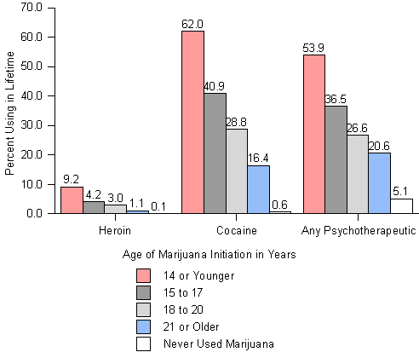
“Gateway” Concept

Slide 45
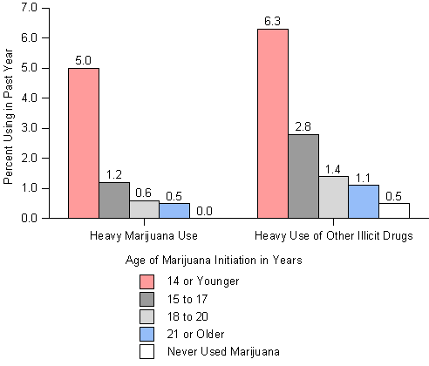
“Gateway” Concept

Slide 46
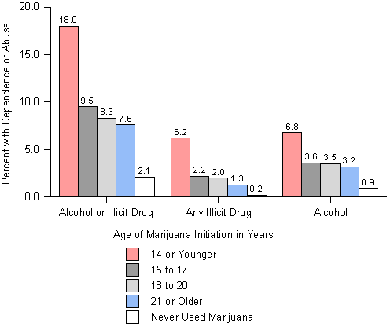
“Gateway” Concept

Slide 47
“Gateway” Concept
In Conclusion,
Use of Marijuana Prior to Age 14 is highly correlated with:
Drug Use/Abuse
Cannabis Abuse in youth is correlated with
Increased truancy/absenteeism
Lower IQ
Poor academic achievement
Impaired Social Development
Correlation does not equal causation
Not Recommended for Youth/Adolescents
Tarter, et al. Am J Psychiatry 2006; 163:2134–2140

Slide 48
Summary
Prop 215 allows MD recommendations NOT Prescription
You are still a physician
History and examination
Documentation
Risks and Benefits
Data on benefits is present although equivocal
Not recommended for youth

