Slide 1
Alcohol and Drug Testing
Addiction Boot Camp
David Kan, MD
www.davidkanmd.com
July 2015

Slide 2
Case 1
Donor tests positive for morphine at 12,254 ng/ml in Urine
Claims poppy seed bagel
You examine him – no evidence of abuse (e.g. needle tracks, withdrawal/intoxication)
Is this a positive drug test?
  Under DOT?
  In OTP?

Slide 3
Case 2
Donor is taking Adderall
Utox comes back positive for
  Amphetamine, dextroamphetamine and methamphetamine
Is this a verified positive test?

Slide 4
Case 3
Donor tests positive for Delta 9THC-COOH
Claims she is taking dronabinol as prescribed by doctor
What test do you do to eliminate illicit cannabis use as an explanation?

Slide 5
Case 4
Patient is prescribed clonazepam for anxiety by PCP.
Patient tests negative on Benzodiazepine drug screen
Patient has clonazepam discontinued and referred to addiction for diversion/addiction
Did the PCP make the right call?

Slide 6
Drug Testing
Only test in Medicine that is face valid
Done correctly, it is what it is.
But what is it?

Slide 7
Introduction
Drug Testing in Context
Medical Review Officer (MRO)
Drugs of Abuse
Alternative Matrices
Drug specific issues

Slide 8
Drug Use in the Worklplace
1 in 12 full-time workers in the US have used illegal drugs in the past month
10% of employees use drugs in the workplace (NIDA)
Substance abusing employees work at 2/3 of capacity (SAMHSA)

Slide 9
Drug Use/Abuse at Workplace
16.4 Million current drug users and 15 million heavy alcohol users work Full-Time
77% of illicit drug users are employed
87% work for small business
1 of every 6 workplace deaths involve drug or alcohol use
25% of workplace injuries d/t drugs or EtOH
Substance abusers 5x more likely to file Worker’s Compensation
SAMHSA “Worker Substance Use and Workplace Policies and Programs”

Slide 10
Minimum Testing Requirements
Specimen Collection
Transport to lab (unless POCT)
Specimen Screen – lab or POC
Specimen Confirmation Test – SAMHSA certified lab
Medical Review Officer

Slide 11
Reasons for Testing
Pre Employment
Random
Post Accident
Reasonable Suspicion
Return to Duty
Follow Up

Slide 12
DOT Urine Drug Test Panel
Marijuana Metabolites (delta-9 THC-COOH)
Cocaine Metabolites (benzoylecgonine)
Amphetamines (Amphetamine/Methamph)
Ecstasy (MDMA, MDA, MDEA)
Opiate metabolites (Morphine, Codeine, 6-AM)
Phencyclidine (PCP)
Specificity (Drug, Cutoff levels, Defined metabolites)

Slide 13
DOT Programs
Urine Collections only – procedures well defined
Federal forms (paper CCF)
Samples tested in certified labs
5 drug panel only
MRO procedures degined
Regulations must be followed precisely

Slide 14
Non-DOT Drug Testing
Options can be modified
Alternative Specimens (saliva, urine, hair)
Analysis: Lab based or POCT (rapid)
Panel: 1-50 drugs – NIDA 5 most common
Cutoff levels may vary – NIDA common
Reasons for test defined by company
Paperless CCF acceptable

Slide 15
Turnaround Times
Specimen method used
Lab-based vs. POCT
Screening test vs. Confirmation
MRO

Slide 16
Delays in Testing
Test result delays
  Positive results – always tested twice
  Second test GC/MS – 100% specific
  Positive results to MRO
  Challenges for MRO in contacting donor
  Shy bladder, interfering substances, canceled tests, CCF issues

Slide 17
Drug Detection Challenges
Medical Marijuana
New drugs – Bath salts, Spice/K2, designer drugs
Adulteration methods
Dilution and substitution
Window of Detection
Cutoff levels

Slide 18
Results of Workplace Drug Testing

Slide 19
MRO Role
Lab Confirms, MRO Verifies
Independent and Impartial Advocate
Gatekeeper of process integrity
Confidentiality
Review all confirmed positives
  Positive
  Adulterated
  Substituted
  Invalid
  Dilute and…

Slide 20
MRO Functions
Review CCF for validity
Interview employee/candidate
Determine if legitimate explanation for + test exists
Report the test as negative, positive, or cancelled
If Test +, Rx legitimate: MRO Negative

Slide 21
Adulteration
Definition:
Addition to the urine of an “exogenous” substance (not normally found in the human body)
OR presence of a “normal” substance at extremely high or low levels not consistent with human urine

Slide 22
Detecting Adulteration:
Specimen Validity Testing
Lab Tests Performed
  pH
  Creatinine
  Specific Gravity
  Adulterants
    Nitrites
    Chromium
    Halogens

Slide 23
Common Adulterants
Acids, Bases and Salt
  Rarely used today; easily detected by pH and specific gravity
Oxidants
  React with drug metabolites preventing detection
  Most effective with marijuana
  Some effect with morphine
  Little or no effect regarding other drugs
Notes:
Acids and bases not used frequently anymore as their presence is easily determined by pH

Slide 24
Common Oxidants
Nitrites
  Clean X, Clear Choice Instant Clean, Whizzies, Urine Luck 6.4
  Elevations by Rx meds and various medical conditions
  Concentrations > 500ug/ml = adulterated
Chromium (VI)
  LL418, Randy’s Clear II, Sweet Pea Spoiler
  Concentrations > 50ug/ml = adulterated
Halogens
  Urine Luck 6.5
  Concentrations > 100ug/ml = adulterated
Notes:
Small amts. Of nitrite are normal in urine and can result from various Rx meds and some medical conditions
Certain workers may be exposed to Chromium VI, but it is converted to Chromium III, not identified
Halogens like Iodine, and periodate; small amts as a result from dietary supplements

Slide 25
Specimen Validity Testing
Adulterated Specimen—The pH is less than 3 or greater than or equal to 11; the nitrite concentration is greater than or equal to 500 mcg/mL; chromium, halogen, glutaraldehyde, pyridine or a surfactant are detected at or above DHHS established cut-offs.
Substituted specimen—Creatinine less than 2 mg/dL and Specific Gravity less than or equal to 1.0010 or greater than or equal to 1.0200
Dilute Specimen—Creatinine greater than or equal to 2 mg/dL, but less than 20 mg/dL and Specific Gravity is greater than 1.0010, but less than 1.0030
Invalid Specimen—Inconsistent creatinine and Specific Gravity results are obtained; pH 3-4.5 or 9-11; nitrite 200-499; possible presence of other adulterants or interferants

Slide 26
Drugs of Abuse
Alcohol
Marijuana
Benzodiazepines (Xanax, Clonazepam, Valium)
Opioids – Prescribed and Not
Cocaine
Stimulants – Prescribed and Not
Many others
  Muscle Relaxants, Sleeping meds “Z-drugs”

Slide 27
Drug Testing
Biological Matrix
  Urine – most common
  Blood – here and now
  Hair – then and there
  Sweat – measurement over time
  Breath – her and now

Slide 28
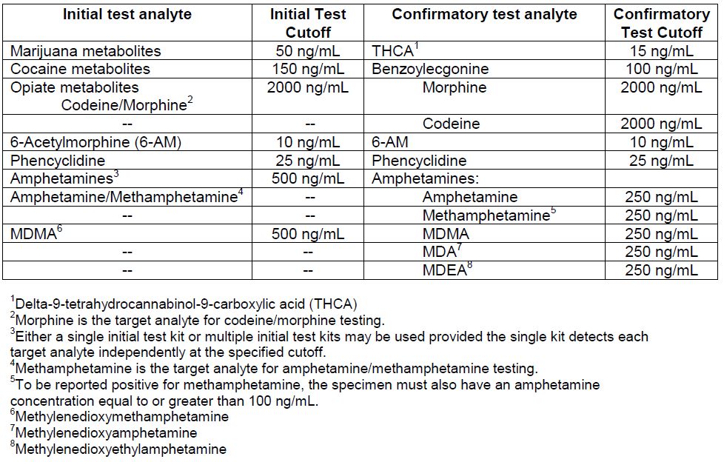
Urine Drug Testing
http://www.samhsa.gov/sites/default/files/mro-manual.pdf

Slide 29
Saliva
Lab or Rapid
Better if lab based
Poor detection of THC
  In order of hours
Adulteration possible
Potential for test of impairment/accident monitoring

Slide 30
Hair Drug Testing
90 day window of detection for all drugs
More expensive than urine
Hairless donors are a problem
Longer turnaround time
Lab based, no POC

Slide 31
Drug Testing
Screening vs. Confirmation
Screening – Wide Net
  Enzyme Linked Immunosorbant Assay
  Higher rates of false positives
  Wide net
Confirmation
  Same specimen
  Gas Chromatography/Mass Spectroscopy (GC-MS)
  Specificity is mixed blessing

Slide 32
Confirmatory Testing
Lock and Key Analogy
What is being tested?
Different panels test different set of drugs

Slide 33
Detection Windows
Shortest to Longest
  Breath
  Blood
  Saliva
  Urine
  Hair/Nails
Sweat variable

Slide 34
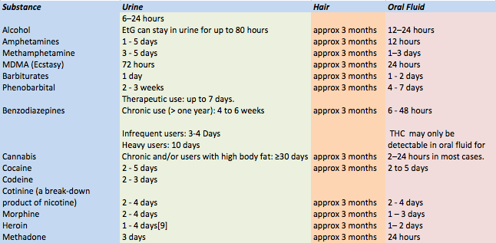
Detection Windows

Slide 35
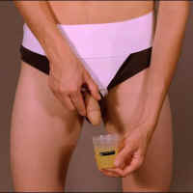
Detection
“THE ORIGINAL WHIZZINATOR”

Slide 36
“Beating the Test”
The best way is to “study”
Adulterated Specimen
  Additives
Substitution
  Many technologies available
  Usually require advance preparation
    Acquisition of fake urine
Dilution
  Water, diuretics

Slide 37
Alcohol
#1 Drug of Abuse
>80% of US Population has had one drink in last year
Alcoholism
  60% variance genetic
  Inborn tolerance to alcohol
  Loss of control
  Level of intoxication linear

Slide 38
Biomarkers of Alcohol Use
Breath/Blood
  Level of impairment based upon level
Indirect Biomarkers (Blood)
  Liver Function Tests
  End Stage Liver Disease
    Pseudonormalization
    Low Platelets
    Slowed Clotting
Direct Biomarkers
  EtG/EtS (urine > blood)
  %CDT
  PETH

Slide 39
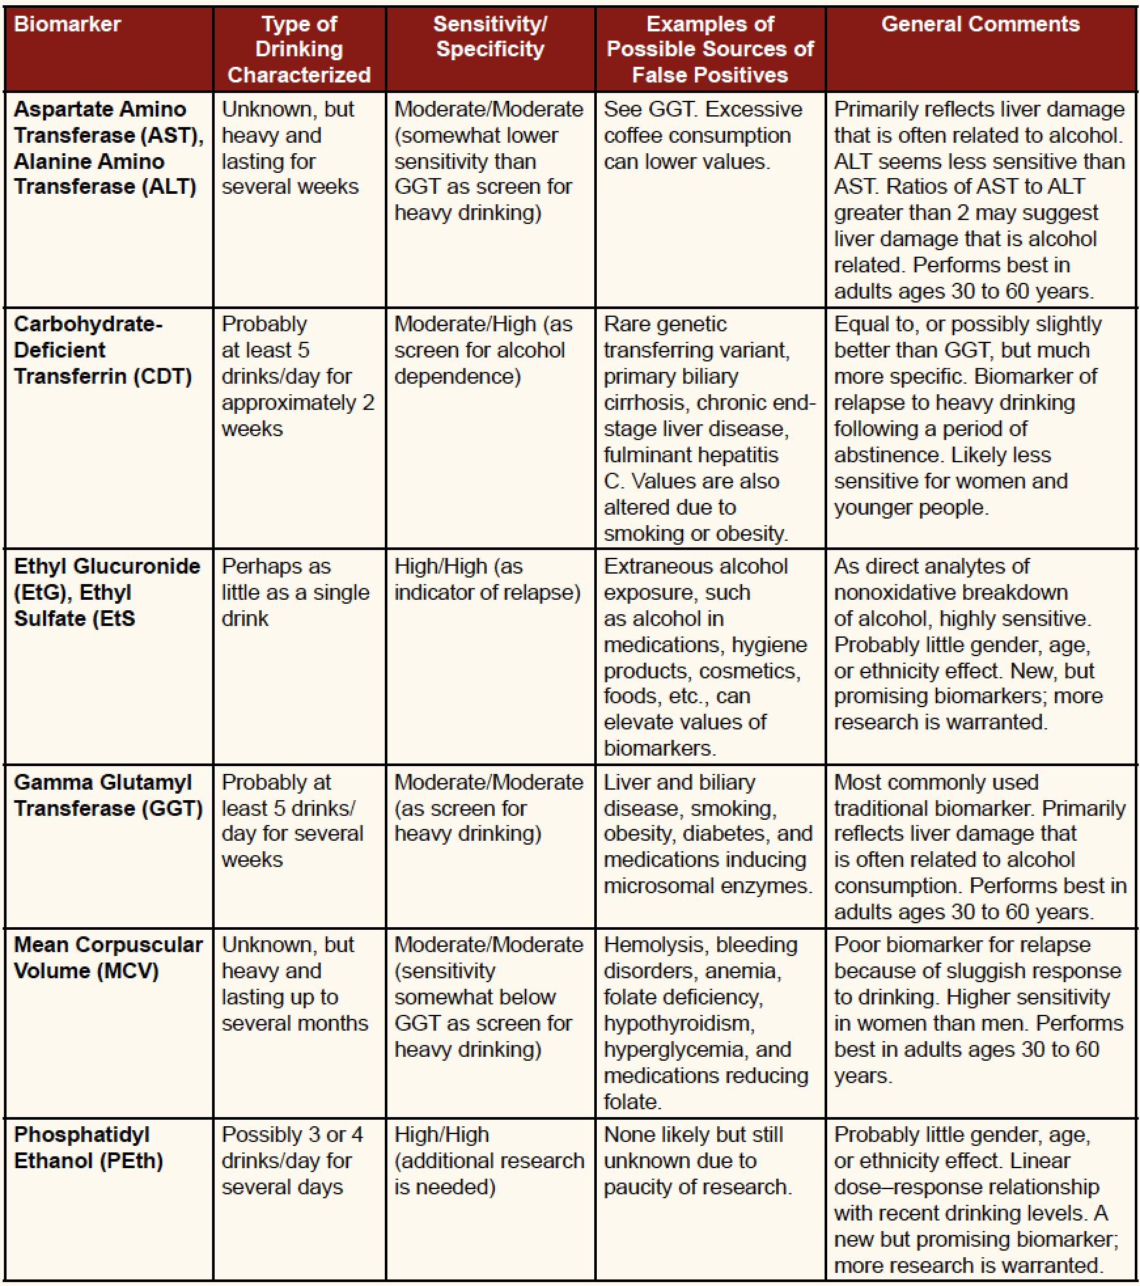
Biomarkers in AUD
SAMHSA 2012

Slide 40
Biomarkers of Alcohol Use
Breath
  Here and now
  Soberlink
    Good for random testing
    Takes Picture
Hair
  EtG/EtS

Slide 41
Monitoring
Drug Testing
  Maintains sobriety
  Does not stop use
Randomness
  Critical to validity
  More impact than frequency
“Monitor”
  3rd party
  Removes adversarial nature

Slide 42
Ongoing Monitoring
Alcohol
  Soberlink
  Useful for current impairment
  EtG/EtS
    Problem with high sensitivity
  %CDT
    Less sensitive in women
    + result = >60grams EtOH daily for 2 weeks
  PeTH – Phosphatidyl Ethanol
    Up to 30 days

Slide 43
Ongoing Monitoring
Cannabis
  Creatinine normalization
Prescription Medications
  Huge challenge
  Functional Restoration vs. Relief from suffering
  DOJ CURES

Slide 44
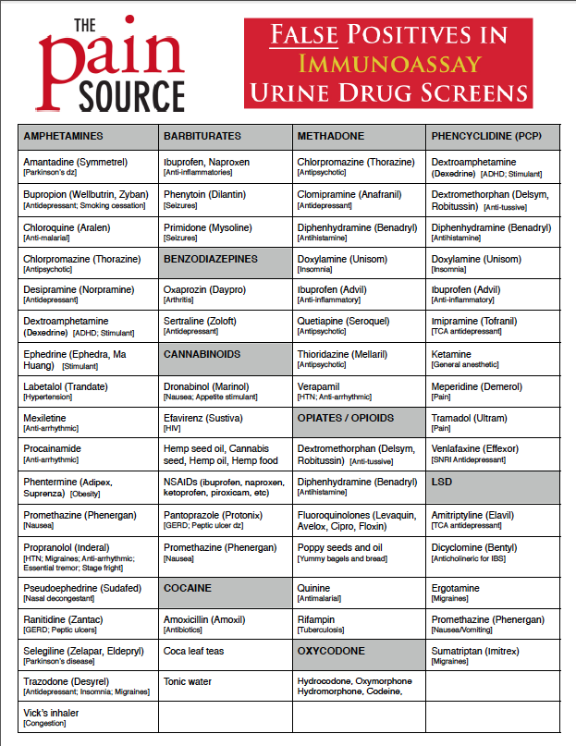
False
Positive
Immuno
Assay
(MANY)

Slide 45
Cannabis Factoids
Prescription THC – causes false + - BUT no presence of other cannabinoids
Passive Inhalation – highly unlikely, low level
Hemp Products
Creatinine Normalization = Level/creatinine
  Sawtooth decline

Slide 46
Cocaine Factoids
Topical Anesthetics (TAC)
Passive Inhalation – unlikely
Coca Leaf Tea
Can be positive up to 7-10 days in very heavy users
Cocaethylene – high potency active pseudo-condensate

Slide 47
Opioids
Consumption of poppy seeds or drugs with codeine or morphine
Semi-Synthetic vs Synthetic inconsistent
  Buprenorphine and methadone test negative
  Oxycodone is messy
6-AM = heroin
Codeine/morphine levels < 15,000 ng/ml
  Evidence of illegal use or opioid - + result
  No clinical evidence – negative
>15,000 ng/ml
  + without legitimate medical explanation
  Legitimate Rx - negative

Slide 48
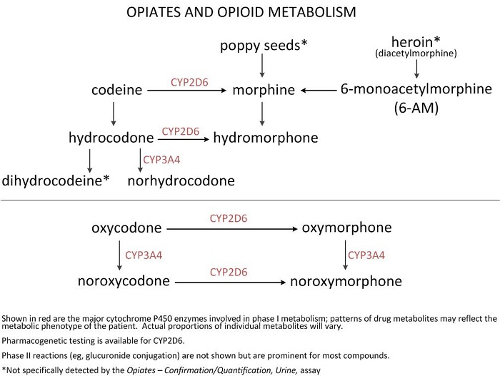

Slide 49
Amphetamine and Meth
Meth metabolizes to Amph
Isomers:
  Vicks = L-Meth > 80% vs. D-Meth
  Selegeline = L-meth/L-Amph only
Most common false positive

Slide 50
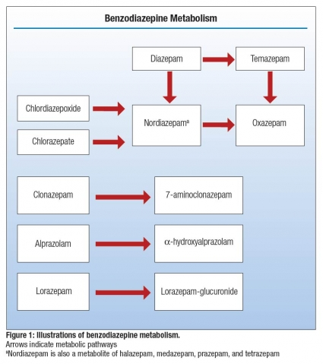
Benzodiazepines
Quirky assay
Negative results
can miss:
  Clonazepam
  Alprazolam
  Lorazepam

Slide 51
Drug Testing
Cutoffs Arbitrary
Depends on the task
Detect any use vs. what would be seen in abuse
What are you trying to prove?

