Slide 1
Alcohol and Drug Testing
American Association of Matrimonial Lawyers
David Kan, MD
www.davidkanmd.com
May 1, 2015

Slide 2
Disclosures
Psychiatrist in private practice
Forensic Fellowship
But I’m not an attorney

Slide 3
Introduction
Working with “Experts”
Substance Use Disorders
Divorce
Drug Testing / Monitoring
Assessment of Substance Use Disorders

Slide 4
Working with “Experts”
Credentials, Knowledge, Certifications
Psychiatrist
Forensic Psychiatry Subspecialty Board
Substance Abuse Specialists
American Society of Addiction Medicine (ASAM) 1980-2008
American Board of Addiction Medicine (ABAM) 2008-present (Includes non-psychiatrists)
Many non-MD specialists
Psychologists Division 50
CAADAC
EXPERIENCE

Slide 5
Medical Review Officer
Knowledgeable about Substance Abuse
Certification and Continuing Education
Qualified to interpret drug tests
Lab Verifies and MRO Confirms

Slide 6
Substance Use Definitions
Problematic Use
Substance Use Disorder (DSM-5)
Mild
Moderate
Severe
Addiction

Slide 7
Acute vs. Chronic Disease Model
Acute Disease
Short-Term Disorder
Severe
Sudden in Onset
Single, Time-limited intervention
Examples:
Common Cold
Broken Bone
Chronic Disease
Long-Term Disorder
Periods of relapse and remission
Requires ongoing rather than acute care
Examples:
Diabetes
Hypertension
Addiction

Slide 8
Substance Use Disorders (SUD)
Prevalence
Alcohol - 1 in 12
Other Drugs – 8% (Cannabis majority)
Clinical Course
Relapsing / Remitting
Great mimicker of Psychiatric Disorders
Alcohol and Anxiety
Cocaine and Methamphetamine and Mood Disorders
Co-occurring Disorders are very common

Slide 9
Clinical SUD Presentation
Spectrum of assessment and treatment
Screening and Brief Intervention
Delivered by Primary Care Provider
Treatment Seeking
Liver
Lover
Livelihood
Law

Slide 10
SUD and Divorce
Presentations
Allegations
Historical SUD with Relapse
Prescription drug abuse
Admission of SUD but minimized
Discovered in Child Custody/Other evalautions

Slide 11
SUD Treatment
ASAM Patient Placement Criteria
Different levels of care
Screening to inpatient hospitalization
Level of care based on criteria
Patient factors
Health factors
Patients need to accept recommendation
Only 30% of patients ever receive treatment
Less than 10% get Medication-Assisted Treatment

Slide 12
Drug Testing
Only test in Medicine that is face valid
Done correctly, it is what it is.
But what is it?

Slide 13
Drugs of Abuse
Alcohol
Marijuana
Benzodiazepines (Xanax, Clonazepam, Valium)
Opioids – Prescribed and Not
Cocaine
Stimulants – Prescribed and Not
Many others
Muscle Relaxants, Sleeping meds “Z-drugs”

Slide 14
Drug Testing
Biological Matrix
Urine – most common
Blood – here and now
Hair – then and there
Sweat – measurement over time
Breath – her and now

Slide 15
Drug Testing
Screening vs. Confirmation
Screening – Wide Net
Enzyme Linked Immunosorbant Assay (ELISA)
Higher rates of false positives
Wide net
Confirmation
Same specimen
Gas Chromatography/Mass Spectroscopy (GC-MS)
Specificity is mixed blessing

Slide 16
Confirmatory Testing
Lock and Key Analogy
What is being tested?
Different panels test different set of drugs

Slide 17
Detection Windows
Shortest to Longest
Breath
Blood
Saliva
Urine
Hair/Nails
Sweat variable

Slide 18
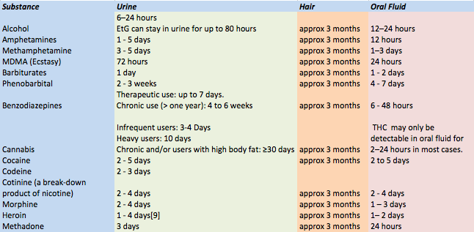
Detection Windows

Slide 19
Problems with Relying on Drug Testing
Chain of Custody
Wrong test ordered
Medications blinding results
Randomness, or the lack thereof
False Positives do exist

Slide 20
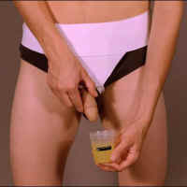
Detection
“THE ORIGINAL WHIZZINATOR”

Slide 21
“Beating the Test”
The best way is to “study”
Adulterated Specimen
Additives
Substitution
Many technologies available
Usually require advance preparation
Acquisition of fake urine
Dilution
Water, diuretics

Slide 22
Specimen Validity Testing
Adulterated Specimen—The pH is less than 3 or greater than or equal to 11; the nitrite concentration is greater than or equal to 500 mcg/mL; chromium, halogen, glutaraldehyde, pyridine or a surfactant are detected at or above DHHS established cut-offs.
Substituted specimen—Creatinine less than 2 mg/dL and Specific Gravity less than or equal to 1.0010 or greater than or equal to 1.0200
Dilute Specimen—Creatinine greater than or equal to 2 mg/dL, but less than 20 mg/dL and Specific Gravity is greater than 1.0010, but less than 1.0030
Invalid Specimen—Inconsistent creatinine and Specific Gravity results are obtained; pH 3-4.5 or 9-11; nitrite 200-499; possible presence of other adulterants or interferants

Slide 23
Alcohol
#1 Drug of Abuse
>80% of US Population has had one drink in last year
Alcoholism
60% variance genetic
Inborn tolerance to alcohol
Loss of control
Level of intoxication linear

Slide 24
Biomarkers of Alcohol Use
Breath/Blood
Level of impairment based upon level
Indirect Biomarkers (Blood)
Liver Function Tests
End Stage Liver Disease
Pseudonormalization
Low Platelets
Slowed Clotting

Slide 25
Biomarkers of Alcohol Use
Breath
Here and now
Soberlink
Good for random testing
Takes Picture
Hair
EtG/EtS

Slide 26
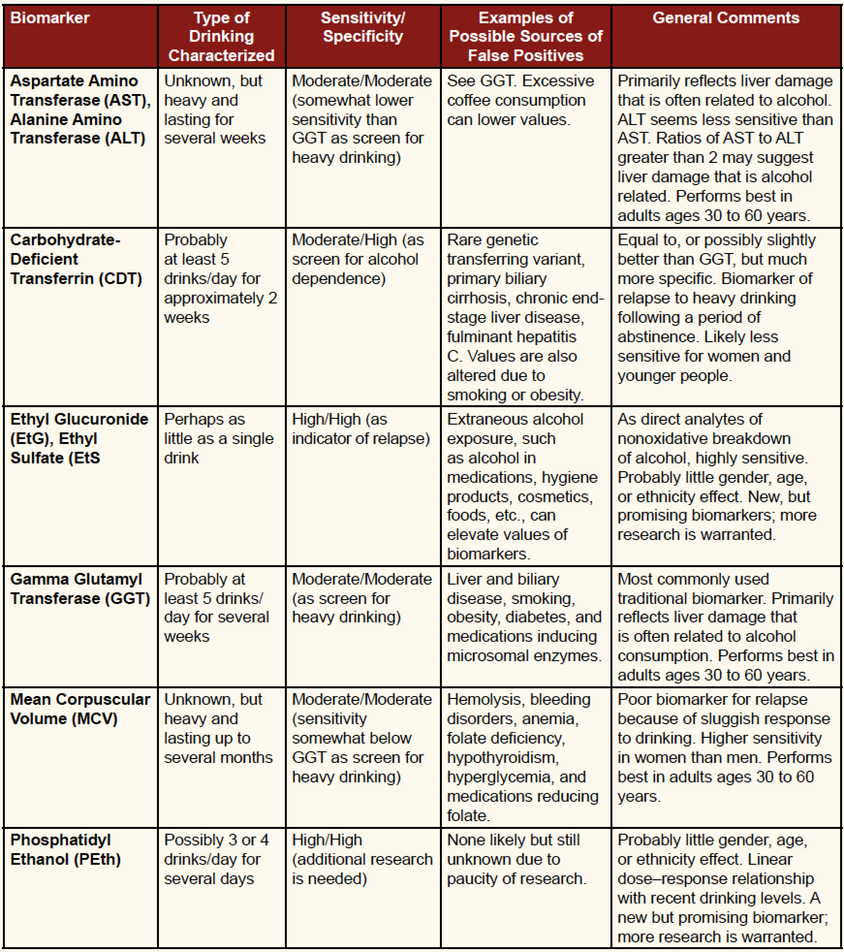
Biomarkers in AUD SAMHSA 2012

Slide 27
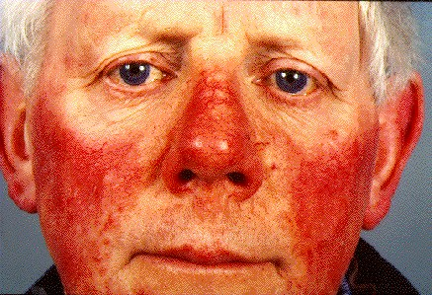
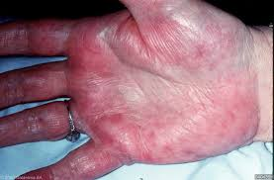
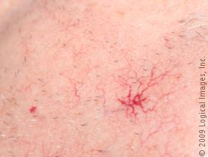
Physical Symptoms of Alcoholism
Rosacea
Tremor in AM
Alcohol on Breath
Swollen/Shrunken liver
Spider Angiomata
Jaundice
Hemorrhoids
Incoordination/Confusion

Slide 28
Monitoring
Drug Testing
Maintains sobriety
Does not stop use
Randomness
Critical to validity
More impact than frequency
“Monitor”
3rd party
Removes adversarial nature

Slide 29
Ongoing Monitoring
Alcohol
Soberlink
Useful for current impairment
EtG/EtS
Problem with high sensitivity

Slide 30
Ongoing Monitoring
Cannabis
Creatinine normalization
Prescription Medications
Huge challenge
Functional Restoration vs. Relief from suffering
DOJ CURES

Slide 31
SUD Assessment
Clinical Interview
Focused Assessment
Could take several hours face to face
Assess for other Psych
Medical Records
Collateral Interviews
Drug Testing
Psychological Testing – limited use by self

Slide 32
Assessment
Addicted individual has incentive to conceal
Many DSM-5 criteria require self-disclosure
“Denial” may just be the truth
Recreational use does exist and is more common than addiction
Laboratory assessment important

Slide 33
DUI Offenders
More than 80% of DUI offenders have a significant problem in their relationship with alcohol and/or other drugs ¹
A five-year follow-up study of convicted DUI offenders
85% of the female offenders and 91% of the male offenders met lifetime criteria for alcohol abuse or alcohol dependence
32% of females and 38% of males met lifetime criteria for a non-alcohol related substance use disorder ²
1. Timken, 1999; Lapham,et al., 2001; Brinkmann, Beike, Köhler, Heinecke, & Bajanowski,
2002; See Lapham, et al, 2004 for a review
2. Lapham, Smith, C’de Baca, Chang, Skipper, Baum, & Hunt, 2001.

Slide 34
Abstinence vs. Moderation
Many roads to recovery
Medication Assisted Treatment (MAT)
Antabuse – makes you sick if you drink
Naltrexone/Topiramate – reduces cravings and drinking
Acamprosate – reduces relapses – unsure why
Can test for presence of medication
Courts should weigh this but as part of a comprehensive plan of treatment and monitoring
Alcoholics Anonymous
Dose response

Slide 35
Alcohol and Drug Testing Conclusions
Cutoffs Arbitrary
+ Drug test does not always mean addiction
Drug test means little without full assessment
The best use of testing is to prevent relapse
Randomness, randomness, randomness

