Slide 1
Other Drugs…
David Kan, MD
www.davidkanmd.com
(925) 953-2833
Notes:
Artist

Slide 2
Disclosures
None

Slide 3
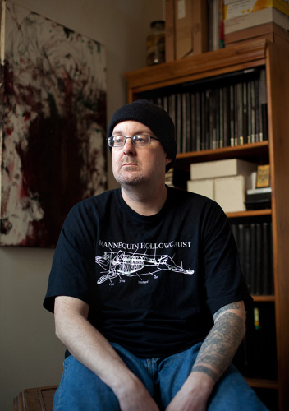
Bryan Lewis Saunders
Notes:
----- Meeting Notes (10/20/15 21:08) -----
Bryan Lewis Saunders is an artist from WAshington DC On March 30, 1995, Saunders began drawing at least one self-portrait every day for the rest of his life. For weeks, in 2001, Saunders conducted an experiment in which he ingested or inhaled a different intoxicant every day then self portrait
Remember the face and body habitus.

Slide 4
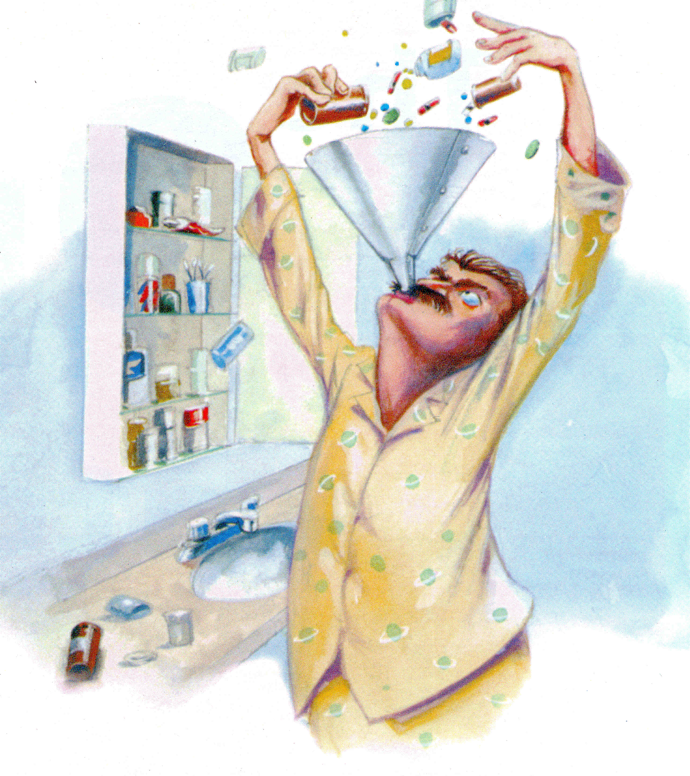
Taking Rx is American
% Taking RX | At least ONE | THREE or more | FIVE or more
1998-1994 | 39.1% | 11.8% | 4.0%
2009-2012 | 47.3% | 20.6% | 10.1%
http://www.cdc.gov/nchs/data/hus/hus14.pdf#glance
Notes:
----- Meeting Notes (10/20/15 21:08) -----
The amount of prescription use has increased. Map well onto pharmaceutical marketing efforts

Slide 5
Special Populations
Youth
Lack access or funds to purchase other drugs
Context of experimentation
Believe prescription medications are safer
Prisons
High rates of addiction
Health Care Professionals
Access to drugs
Friedman, R. A. (2006). NEJM, 354, 1448-1450.
Notes:
----- Meeting Notes (10/20/15 21:08) -----
Culled from clinical experiences, and a review of the literature.
Youth experiment - perception is that Rx is safer
Prisons - unfortunate rates of incarceration
Health Care Professionals - Access

Slide 6
Overview
Many prescription and OTC medications
Focus:
Commonly prescribed and recommended
Lesser known potential for abuse
Groups
Cough, cold, and allergy symptom remedies
Stimulants
Sedatives

Slide 7
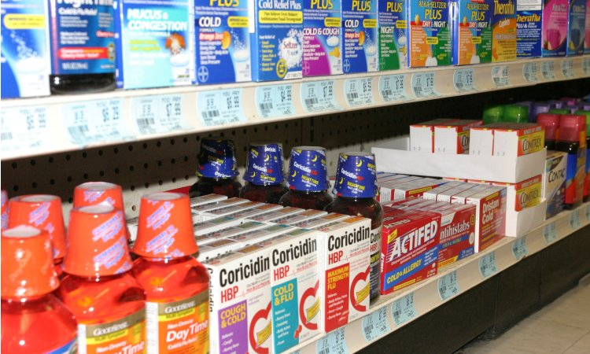
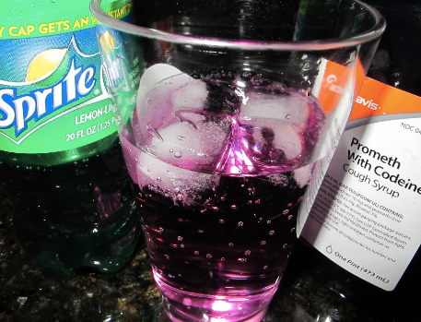
Cough, Cold, and Allergy Symptom Remedies
Notes:
----- Meeting Notes (10/20/15 21:08) -----
Anybody recognize that on the right - shout it out!
Purple Drank

Slide 8
Case #1
19 y/o male found unresponsive by GF
Last night drinking EtOH and cough syrup to get “high”
EMT administered naloxone which improved level of consciousness, O2 started
In ED: c/o hearing loss and tinnitus
BP 99/66, HR 110 BPM, RR 20/min, T 96.8, 02 Sat 80% on room air

Slide 9
Case #1
Exam – lethargic, responsive to voice, oriented x 3, pinpoint pupils, decreased hearing bilaterally
Breath shallow with rales audible at both lung bases
Hypoactive bowel sounds
Skin warm and moist
Admitted to ICU for aspiration pneumonitis, ARDS, Rhabdomyolisis, acute renal failure
Hearing loss and tinnitus resolved
Intubated on HD#9 and d/c on HD#14

Slide 10
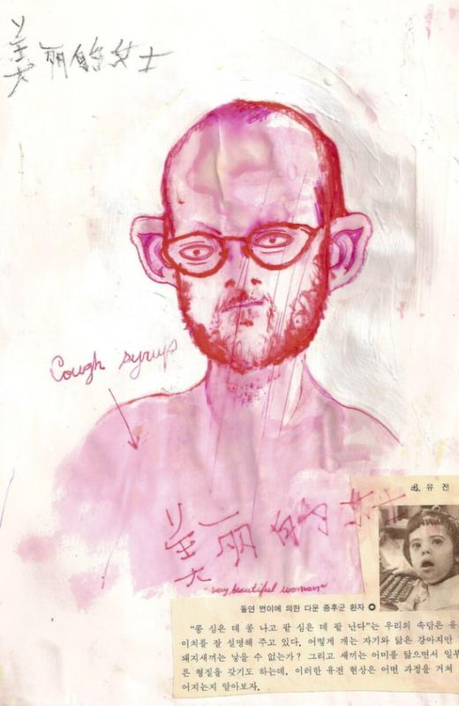
2 bottles of cough syrup
Artist: Bryan Lewis Saunders
(Used with artist permission)

Slide 11
Promethazine
Phenothiazine – sedation and weak antipsychotic
FDA Approved
Allergic conditions – 6.25-12.5mg TID
Nausea/Vomiting – 12.5-25mg q 4-6h
Motion sickness – 25mg BID
Sedation 25-50mg IM/IV
High rates of abuse in Opioid Use disorders
Methadone maintenance – 26% (15% had rx)
Opioid IDU – 17%
Shapiro, J Addiction Medicine, 2013
Laskowski, Emergency Medicine, 2014
Notes:
----- Meeting Notes (10/20/15 21:08) -----
Format I will be using for many of my slides
I know you can read - tell me if I'm going too fast
I will highlight the clinical pearls and takeaways

Slide 12
Promethazine
Identified in 14.2% of methadone toxicity fatalities (Kentucky 2000-2004)
2.5% fatal overdose cases (Seattle 1998-2004)
Potentiates high of methadone
Risks
Apnea and respiratory depression
Injection site reactions
Neuroleptic effects (including NMS)
Coingestion – codeine +/- alcohol
Notes:
----- Meeting Notes (10/20/15 21:08) -----
Tends to get mixed with opioids, alcohol

Slide 13
Dextromethorphan
OTC Cough Suppressant
Cough 10-20mg q4H, TDNTE 120mg/day
Pharmacology: Suppresses medullary cough center, NMDA receptor antagonist at higher doses
Street names
"tussin," "robo," "dex," "triple C's," and "skittles."
Euphoriant Effects
Heightened perceptual awareness, altered time perception, and visual hallucinations
Clinical Presentation
Hyperexcitability, lethargy, ataxia, slurred speech, sweating, hypertension, and/or nystagmus
Notes:
----- Meeting Notes (10/20/15 21:08) -----
NMDA receptor antagonist at higher doses
PCP like effects
Many stimulant effects but also slurred speech, ataxia, nystagmus

Slide 14
Dextromethorphan
Plateau | Dose (mg) | Behavioral Effects
1st | 100–200 | Mild stimulation
2nd | 200–400 | Euphoria and hallucinations
3rd | 300– 600 | Distorted visual perceptions
 |  | Loss of motor coordination
4th | 500-1500 | Dissociative sedation
Notes:
----- Meeting Notes (10/20/15 21:08) -----
6-10mg/ml
Tpical bottle 120ml
=1200mg in 4 oz bottle

Slide 15
Dextromethorphan
Monitoring the Future Study 2012 Reporting non-medical use in last year
3% of 8th Graders
4.7% of 10th Graders
5.6% of 12th Graders
Retrospective California Poison Control System Study 1999-2004
10x increase in DXM abuse in all ages
15x increase in DXM in adolescents
CPCS
2004 – 1382 DXM abuse cases
75% between 9-17 y/o, Median age 16
Notes:
----- Meeting Notes (10/20/15 21:08) -----
INcreasing rates of experimentation amongst youth and consequent trouble

Slide 16
Diphenhydramine
FDA approval
Allergy sx – 25-50mg q4-6PRN – TDNTE 300mg/day
Allergic Rxc mod-severe – 25-50mg – TDNTE 300mg/day
Extrapyramidal Sx – 25-50mg q6-8 – TDNTE 300mg/day
Insomnia, short-term – 25-50mg po prn
Motion Sickness prevention – 25-50mg po q 4-6
Sedation 25-50mg po
IM/IV dosing 33% greater Total dose/day
Notes:
----- Meeting Notes (10/20/15 21:08) -----
Diphenhydramine
Allergic reactions
however it shows up in a number of OTC medications (sleepers)
Patients commonly unaware they are taking it

Slide 17
Diphenhydramine
H1 Receptor antagonist
Central anticholinergic effects at higher doses
Sedating effects at low dose
Higher doses (300mg+)
Euphoric High
Hallucinations
Increased Dopamine in NAc
Adolescents at risk
Halpert, AG., Neuroscience and Behavioral Reviews. 26, 2002
Notes:
----- Meeting Notes (10/20/15 21:08) -----
Dopamine increase

Slide 18
Doxylamine
FDA Approval - OTC
Insomnia – 25-50mg PO PRN
Allergy – 12.5mg q 4-6
H1 receptor antagonist
Central anticholinergic effects at higher doses
Similar to Diphenhydramine BUT
Risk of Rhabdomyolysis at higher doses
Notes:
----- Meeting Notes (10/20/15 21:08) -----
Doxylamine - Rhabdo at higher doses

Slide 19
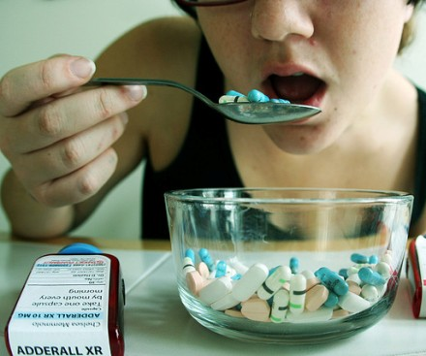
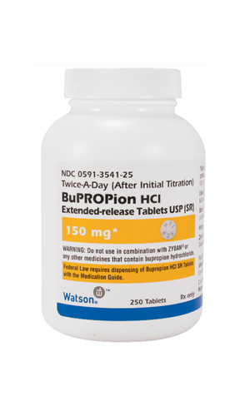
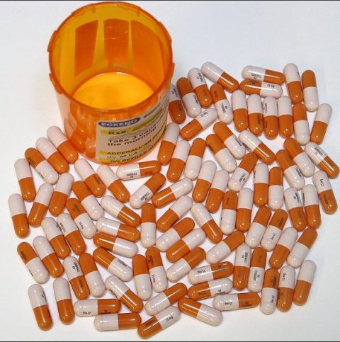
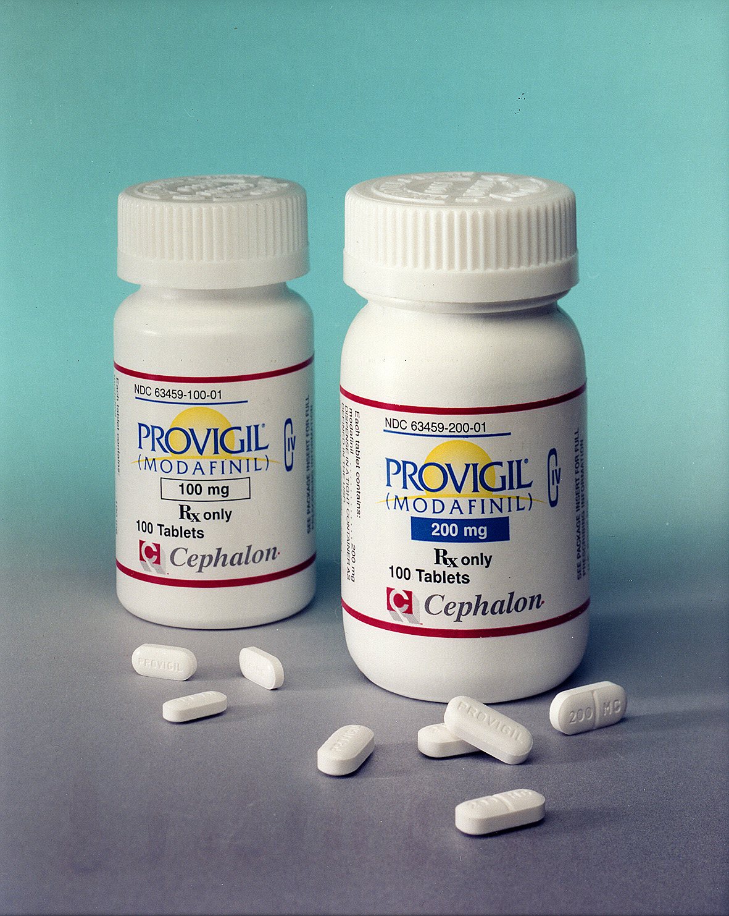
Stimulants

Slide 20
Case #2
20 y/o female graduate student – seen in student health with complaints of difficulty focusing and declining grades
Reports hx of ADHD. Prescribed mixed amphetamine salts 30mg in AM and 20mg at 2PM
Requested an increase in stimulant dose to help with focus
Presents as underweight, agitated, irritable
CURES report shows 2 prescribers prescribing ~160mg of mixed amphetamine salts a day
Exam shows evidence of chronic picking, blue-boggy mucosa in nares, 5’4”, 100lbs – BMI = 17
UDS - + for amphetamine, dextroamphetamine

Slide 21
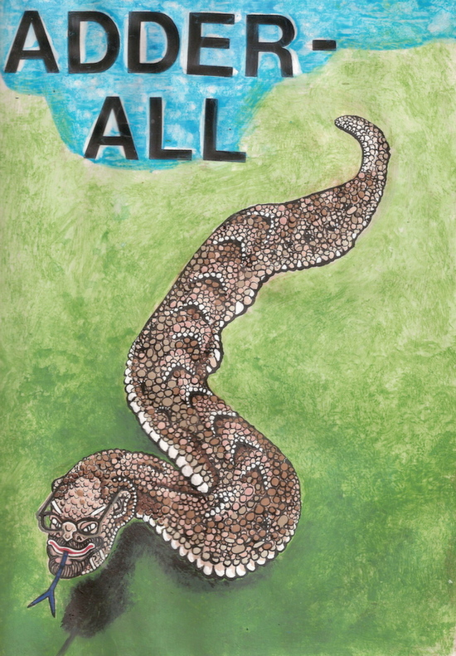
10mg of mixed amphetamine salts
Artist: Bryan Lewis Saunders
(Used with artist permission)

Slide 22
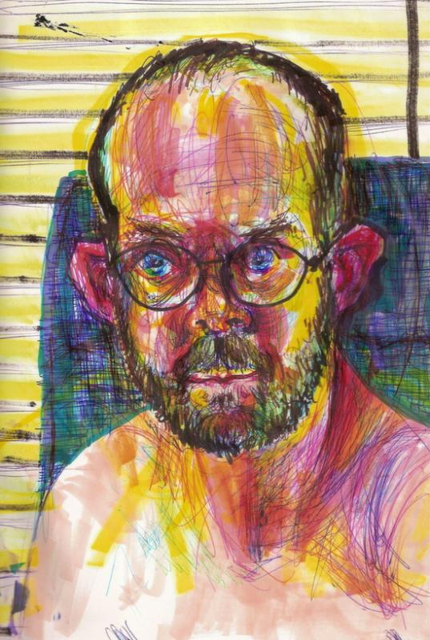
Methylphenidate Snorted (dose unknown)
Artist: Bryan Lewis Saunders
(Used with artist permission)

Slide 23
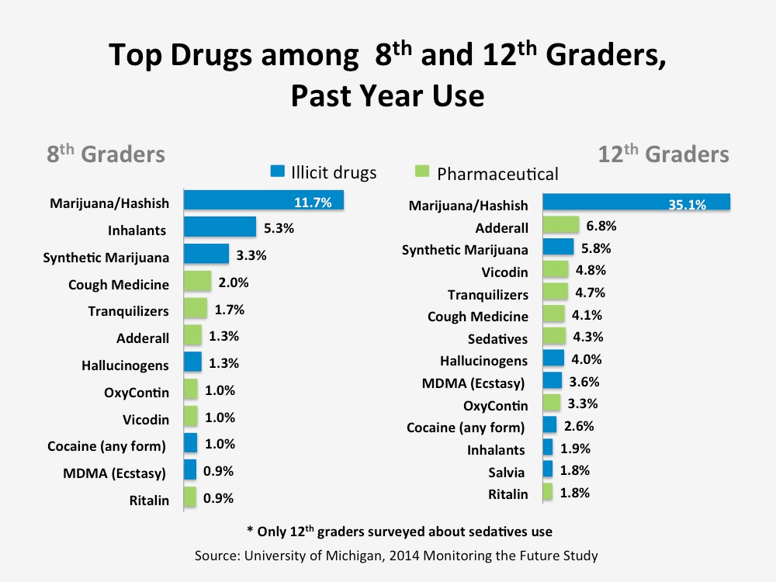
Top Drugs Used in 8th and 12th Graders Past Year Use
Notes:
----- Meeting Notes (10/20/15 21:08) -----
Stimulants - drugs of youth although older populations affected more

Slide 24
Past 5 Year Drug Use in 12th Graders
Notes:
----- Meeting Notes (10/20/15 21:08) -----
2014 MTF 2010-2014
And amphetamines speeds ahead

Slide 25
Stimulants
Attention Deficit Hyperactivity Disorder
Notes:
----- Meeting Notes (10/20/15 21:08) -----
Kids have some rate of prescribing but all kinds of access
Look at that - I want to be back in high school
Diversion is the frequent

Slide 26
Stimulants
FDA approved for ADHD, Narcolepsy
Mixed Amphetamine salts
ADHD – 5-40mg/day
Narcolepsy 5-60mg/day
Methylphenidate
ADHD 10-45mg/day
Narcolepsy 10-45mg/day
Notes:
----- Meeting Notes (10/20/15 21:08) -----
Dose recommendations
Guide data for maximums is pretty poor
Risk benefit analysis

Slide 27
Stimulants
Most obtained free from friend
Oral, intranasal, injection
5.3% college students currently prescribed ADHD medications
61.7% prescribed diverted
Risk Factors
Childhood conduct problems
Cannabis Use Disorder
Increasing use in adults for performance enhancement
Notes:
----- Meeting Notes (10/20/15 21:08) -----
Diversion is cheap - free mostly
6/10 prescriptions diverted
Risk factors:
Conduct problems
Cannabis use disorder
Wait! you can go back to high school!

Slide 28
Characteristics of Nonmedical Stimulant Use
Excessive drinking and other drug use
Lower GPA
Low perceived harmfulness of Rx use
Attention difficulties
Psychiatric distress or depressed mood
Skipping classes
Affiliation with fraternity/sorority
Notes:
----- Meeting Notes (10/20/15 21:08) -----
Risk Factors
Poor achievement
Co-occurrence
Fraternity/Sorority membership

Slide 29
Implications
GPA drops
Health care
Mindful of prevalence of diversion
Clear instructions on use and disposal
Drug testing
Notes:
----- Meeting Notes (10/20/15 21:08) -----
Transcript in student health - recommend it highly
GPA drops
Diversion potential
Drug testing

Slide 30
Bupropion
FDA Approved
Major Depressive Disorder – 150-450mg daily
Seasonal Affective Disorder – 300mg daily
Smoking Cessation – 300mg daily
Off label
ADHD – up to 450mg daily
Notes:
----- Meeting Notes (10/20/15 21:08) -----
Indications and dose ranges

Slide 31
Bupropion
Cathinone derivative like “bath salts”
Stimulant effects when smoked or snorted
“Wellies”, “welbys”, “barnies”, “dubs”
Amphetamine a minor metabolite
Risks:
Seizure
Hypertension
QTc and QRS prolongation (blocks cardiac gap junctions – refractory to sodium bicarb)
Notes:
----- Meeting Notes (10/20/15 21:08) -----
Same family as bath salts
Amphetamine a minor metabolite
Stimulant effects
QTc/QRS prolongation refractory to Sodium Bicarb

Slide 32
Modafinil/Armodafinil
Modafinil FDA Approved
Narcolepsy - 200mg, TDNTE 400mg/day
OSA/hypopnea - 200mg, TDNTE 400mg/day
Shift work sleep disorder – 200mg – higher doses rarely effective
Off-label
MS fatigue – 200mg, TDNTE 400mg/day
Armodafinil FDA approved
Narcolepsy – 150-250mg qAM
OSA/Hypopnea – 150-250mg qAM
Shift work sleep disorder – 150mg daily
Notes:
----- Meeting Notes (10/20/15 21:08) -----
Wakefulness improving agent
Often used to combat sedative effects of opioids

Slide 33
Modafinil/Armodafinil
Schedule IV
Promotes wakefulness without sleep rebound
Blocks dopamine transporters
~equivalent to methylphenidate
Abuse reported in health care professionals
Notes:
----- Meeting Notes (10/20/15 21:08) -----
Block dopamine transporters
Health care professionals

Slide 34
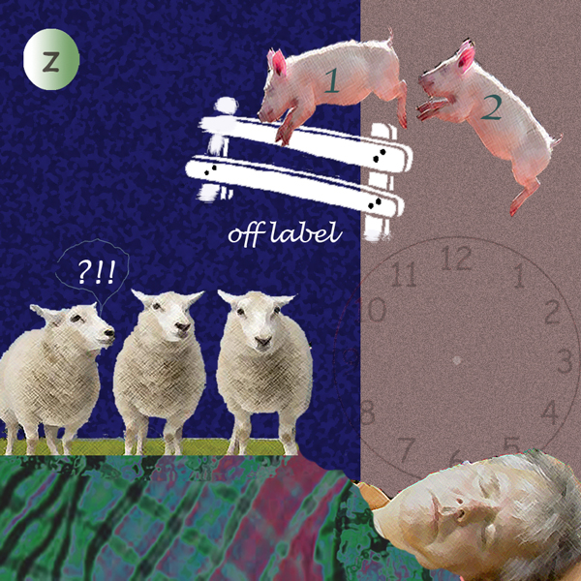
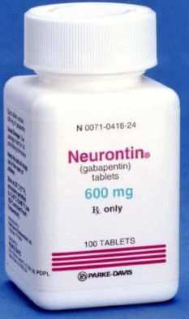
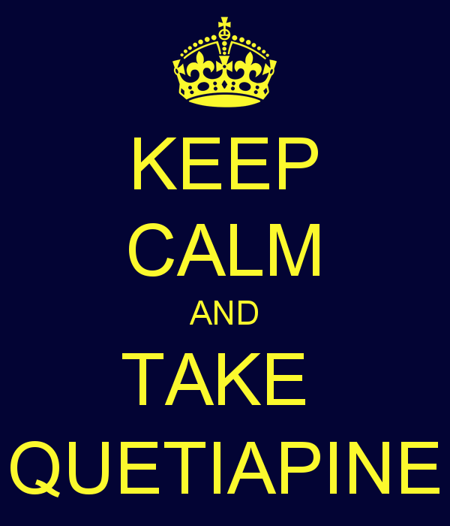
Sedatives

Slide 35
Case #3
67 y/o woman with hx of depression and alcohol abuse
Prescribed gabapentin, naproxen, amitryptaline for pain from polyneuritis
Prescribed 4800mg/day – taking 7200mg daily
Requested gabapentin without prescription from pharmacists and numerous physician exaggerating her symptoms to obtain quantities

Slide 36
Case #3
No longer able to obtain
Withdrawal symptoms
Trembling, sweating, excitation, pallor, exopthalmia
Required hospitalization treated for DT

Slide 37
Gabapentin
FDA approved anticonvulsant and analgesic
Indications:
Partial Seizures 300-1200mg TID
Post-herpetic neuralgia 300-600mg TID
Neuropathic Pain 300-1200mg TID
Pharmacology
Chemically similar to gamma-aminobutyric acid (GABA)
Interaction with voltage-gated calcium channels
Possibly halts formation of new synapses
Notes:
----- Meeting Notes (10/20/15 21:08) -----
Gabapentin
Let's put it in the water - when I was a resident
Indications are for pain and seizure
Looks like GABA
? halt formation of synapsis?

Slide 38
Pregabalin
FDA approved pain and seizure adjunct
Neuropathic pain, diabetic – 50-100mg TID
Neuropathic pain, SCI – 75-300mg BID
Post-herpetic neuralgia – 150-300mg/day BID-TID
Partial seizures, adjunct tx – 150-600mg/day BID-TID
Fibromyalgia – 150-225mg BID
Pharmacology
More rapid oral absorption than gabapentin (Peak plasma level ~1 h vs. Gabapentin 3-4 h)
Notes:
----- Meeting Notes (10/20/15 21:08) -----
Like gabapentin but at 1/2-14 the dose
More rapid oral absorption

Slide 39
Gabapentinoid Abuse
Drug liking/desire – insignificant in tx doses
Evidence outside of US of abuse
Typically with patients with hx of drug abuse
Reported High
Cannabinoid type
MDMA type
‘Zombie-like’
Combinations common
Cannabis, alcohol, SSRI, LSD, GHB, opioids
Schifano, CNS Drugs (2014) 28:491-496
Notes:
----- Meeting Notes (10/20/15 21:08) -----
Not much fun at lower doses
Hx of drug abuse
Combined

Slide 40
Gabapentinoid Abuse
Drug seeking behaviors
Withdrawal symptoms upon cessation
Banned in numerous correctional facilities
Snorted, exchanged
Vigneau, CV. Pharmacopsychiatry. 40, 2007
Pittenger, C. Psychiatry. 68:8. 2007
Notes:
----- Meeting Notes (10/20/15 21:08) -----
Correctional facilities

Slide 41
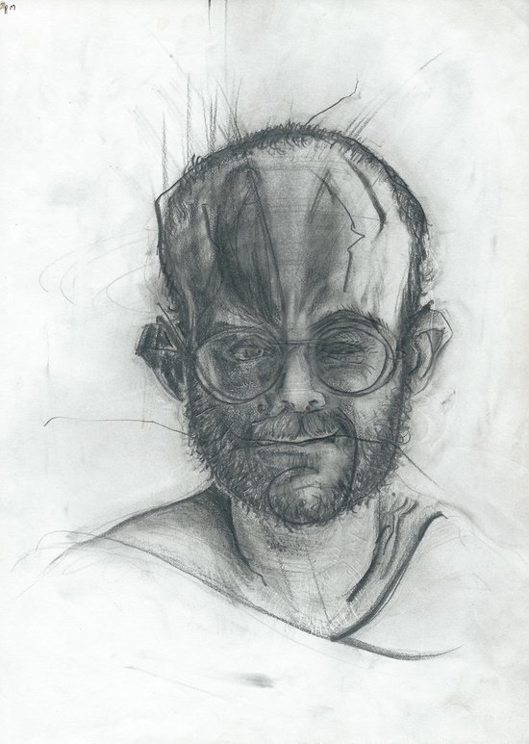
Artist: Bryan Lewis Saunders
Quetiapine 100mg
(Used with artist permission)

Slide 42
Quetiapine
FDA Approved
Schizophrenia – 150-750mg daily
Bipolar Mania – 200-400mg BID
Bipolar Depression – 300mg qHS
Pharmacology
Potent Serotonin 5-HT2a antagonist
Moderate Dopamine D2-receptor antagonist
Mild antagonism 5HT1a, D1, H1, alpha 1-2
Notes:
----- Meeting Notes (10/20/15 21:08) -----
Good for much and thusly used for much
Sedative unlike any other (clinical experience)
Significant risks - metabolic syndromes, TD

Slide 43
Quetiapine
Atypical Antipsychotic
quell, Suzie Q, baby heroin
Replaces heroin in cocaine-heroin speedball
Mechanism - Histamine H1 antagonism
Correctional Malingering – 1/3 of LA County Jail
Waters, BM., Am J Psychiatry 164:1, 2007
Pierre, JM., Am J Psychiatry. 161:9, 2004
Notes:
----- Meeting Notes (10/20/15 21:08) -----
Replaces heroin in cocaine-heroin speedball
malingered for in 1/3 of county jail

Slide 44
Quetiapine Misuse
Sansone & Sansone, Psychiatry (Edgmont) 2010
Notes:
----- Meeting Notes (10/20/15 21:08) -----
Polysubstance abuse - tautalogical?
Feigned psychosis

Slide 45
Tricyclic Antidepressants
Tertiary TCA (doxepin, amitryptaline, imipramine)
Anticholinergic / antihistaminergic / anti-alpha
Patients report psychostimulant effect
Intranasal, injected
MEX – Methadone, Elavil, Xanax
At-risk
Comorbid substance use and mood disorder
Hypotension/orthostasis
Cardiotoxicity from sodium channel blockade
Evans, Subst Abuse Rehabil 2014
Notes:
----- Meeting Notes (10/20/15 21:08) -----
TCA - few antidepressants work better
Tertiary amines
Broad effect spectrums
Cardiotoxicity is greatest risk - LD50 is low!

Slide 46
Nitrous Oxide
Anesthetic and food preparation
“Laughing gas” or “whippits”
Deactivates B12 – neuropathy
AE – Seizure, Myelopathy (reversible early)
At risk:
Dentists, anesthesiologists
Teens <1% inhalants
Notes:
----- Meeting Notes (10/20/15 21:08) -----
Whippits
Chronic heavy use seizure and myelopathy through B12 deactivation - B12 levels normal on labs

Slide 47
Case #4
27 y/o Asian male
Reports taking carisopradol up to 40 tablets a day
Abruptly stopped
Presents to ED one week later with waxing and waning attention, confusion, disorientation, and visual hallucinations
Oral Lorazepam initiated with CIWA protocol initiated
Delirium rapidly resolved, discharged on HD#3

Slide 48
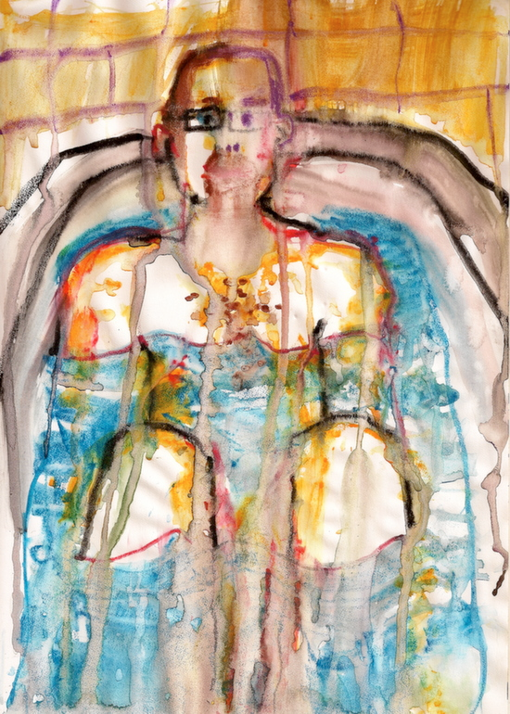
250mg Carisopradol
Artist: Bryan Lewis Saunders
(Used with artist permission)

Slide 49
Carisoprodol
Centrally acting muscle relaxant
FDA Approved
Acute musculoskeletal pain – 250-350mg TID and qhs
Metabolized into meprobamate
2.1% Lifetime non-medical use ~2.3 million (2012 NSDUH)
Blurred vision, dizziness, drowsiness, loss of coordination
Notes:
----- Meeting Notes (10/20/15 21:08) -----
Muscle Relaxants
Acute pain indication - not chronic!
Meprobamate
clinically looks like drunkeness

Slide 50
Carisopradol
“High” – euphoriant, sedation, body warmth, dream-like state
Withdrawal:
Cramps, headache, insomnia, nausea, seizures, DT
Medical: Bezoar formation
Asians
All ages
Notes:
----- Meeting Notes (10/20/15 21:08) -----
Withdrawal can be severe with higher doses
Bezoar
Asians - in San Francisco - freq. those that turn red with drinking

Slide 51
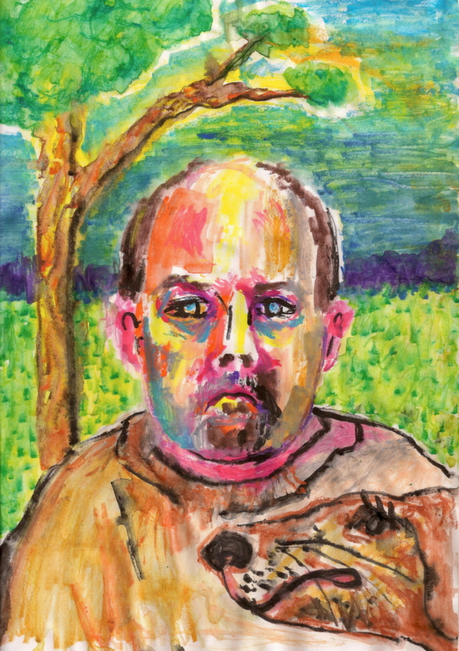
20mg of Cyclobenzaprine
Artist: Bryan Lewis Saunders
(Used with artist permission)

Slide 52
Cyclobenzaprine
FDA Approved
Muscle Spasm: 5-10mg TID up to 3 wk
Pharmacology:
Centrally Acting muscle relaxant
Potentiates norepinephrine, binds serotonin receptors reducing spasticity
“cyclone” “mellow yellow”
Euphoriant effects: Relaxation, incoordination
Abused to potentiate opioids
Notes:
----- Meeting Notes (10/20/15 21:08) -----
Approved for muscle spasm
Norepinephrine and serotonin receptor
Chemically and mechanistically similar to amitryptaline
Potentiates opioids

Slide 53
Prescription Miranda Rights
You have the right to prescribe or recommend
Anything you prescribe or recommend could and may be abused in the context of “treatment”
Anything you prescribe or recommend may end up in other hands
Notes:
----- Meeting Notes (10/20/15 21:08) -----
You may feel like you are trapped and about to be arrested after this talk as you think about your prescribing patterns.
READ SLIDE
But there's good news - now that you know, here's what you do

Slide 54
Recommendations
Abuse potential difficult to accurately predict
Monitoring abilities limited
Therapeutic alliance critical
Random pill callbacks
Major complications usually late stage or in significant overdose
Patients with SUD history at higher risk
Notes:
----- Meeting Notes (10/20/15 21:08) -----
Therapeutic alliance
SUD history significant - understand abuse potential is not always amongst the most common offenders
At the same time understand that any medication is a trial - more next slide

Slide 55
Recommendations
Universal Precautions
Though abuse risk with many drugs discussed lower
Set and Setting important (prison, OTP, patients with SUD)
Risk Benefit Analysis
Trust but verify
Notes:
----- Meeting Notes (10/20/15 21:08) -----
Universal precautions
-same concept of HIV - all fluids at risk
-Set and Setting - big in addiction - set and setting of prescriber heavily mediates prescribing practices
-Think back to patient who kept getting refills of X - was this because X muscle relaxant really more abusable tha Y opioid - or maybe the MD would notice less
-Understand that out medications have risks just like surgery - yet surgeon may be more explicitly review them?

Slide 56
References
http://www.cdc.gov/nchs/data/hus/hus14.pdf#glance
Halpert, AG., Olmsead, MC., Beninger, RJ. Mechanisms and Abuse Liability of the Anti Histamine Diphenhydramine. Neuroscience and Behavioral Reviews. 26, 2002
Waters, BM., Joshi, KG. Intravenous Quetiapine- Cocaine Use (Q Ball). Am J Psychiatry 164:1, 2007
Pierre, JM., Shnayder, I., Wirshing, DA., Wirshing, WC. Intranasal Quetiapine Abuse. Am J Psychiatry. 161:9, 2004
Vigneau, CV., Guerlials, M., Jolliet, P. Abuse, Dependency, and Withdrawal with Gabapentin: A first Case Report. Pharmacopsychiatry. 40, 2007.
Pittenger, C, Desan, PH. Gabapentin Abuse and Delierium Tremens Upon Gabapentin Withdrawal. J. Clin. Psychiatry. 68:8. 2007.
Evans http://www.ncbi.nlm.nih.gov/pubmed/25187753

Slide 57
References
Arria AM, Wish ED. Nonmedical use of prescription stimulants among students. Pediatric Annals. 2006;35(8):565-571.
Johnston LD, O'Malley PM, Bachman JG, Schulenberg JE. Monitoring the Future: National results on adolescent druguse: Overview of key findings, 2011. Ann Arbor: Institute on Social Research, The University of Michigan;2012.
McCabe SE, Knight JR, Teter CJ, Wechsler H. Non-medical use of prescription stimulants among US college students :Prevalence and correlates from a national survey. Addiction. 2005;99(1):96-106.
Arria AM, O'Grady KE, Caldeira KM, Vincent KB, Wish ED. Nonmedical use of prescription stimulants and analgesics: Associations with social and academic behaviors among college students. J Drug Issues. 2008;38(4):1045-1060.
Teter CJ, McCabe SE, LaGrange K, Cranford JA, Boyd CJ. Illicit use of specific prescription stimulants among college students: Prevalence, motives, and routes of administration. Pharmacotherapy. 2006;26(10):1501-1510.
McCabe SE. Screening for drug abuse among medical and nonmedical users of prescription drugs in a probability sample of college students. Arch Pediatr Adolesc Med. 2008;162(3):225-231.
McCabe SE, Teter CJ, Boyd CJ. Medical use, illicit use and diversion of prescription stimulant medication. J Psychoactive Drugs. 2006;38(1):43-56.
Arria AM, Caldeira KM, O'Grady KE, et al. Drug exposure opportunities and use patterns among college students: Results of a longitudinal prospective cohort study. Subst Abus. 2008;29(4):19-38.

Slide 58
References
Vincent KB, Kasperski SJ, Caldeira KM, et al. Maintaining superior follow-up rates in a longitudinal study: Experiences from the College Life Study. Int J Mult Res Approach. 2012;6(1):56-72.
Garnier-Dykstra LM, Caldeira KM, Vincent KB, O'Grady KE, Arria AM. Nonmedical use of prescription stimulants during college: Four-year trends in exposure opportunity, use, motives, and sources. J Am Coll Health. 2012;60(3):226-234.
DeSantis A, Noar SM, Webb E. Nonmedical ADHD stimulant use in fraternities. J Stud Alcohol Drugs. 2009;70(6):952-954.
DeSantis A, Noar SM, Webb EM. Speeding through the frat house: A qualitative exploration of nonmedical ADHD stimulant use in fraternities. J Drug Educ. 06 2010;40(2):157-171.
DuPont RL, Coleman JJ, Bucher RH, Wilford BB. Characteristics and motives of college students who engage in nonmedical use of methylphenidate. Am J Addict. 2008;17(3):167-171.
Garnier LM, Arria AM, Caldeira KM, Vincent KB, O'Grady KE, Wish ED. Sharing and selling of prescription medications in a college student sample. J Clin Psychiatry. 2010;71(3):262-269

